Slide 1
Generative Adversarial Network and its Applications to Signal Processing and Natural Language Processing
Part II: Speech Signal Processing
Notes:
Hi I am Yu Tsao
I am going to present the second part of this tutorial
GAN for speech signal processing
Q: 可以做得很好? 為什麼?
Q: VAE 為何不好?
Q: unroll GAN有用嗎？

Slide 2
Outline of Part II
Speech Signal Generation
Speech enhancement
Conclusion
Postfilter, speech synthesis, voice conversion
Speech recognition
Speech Signal Recognition
Speaker recognition
Speech emotion recognition
Lip reading
Notes:
This is the outline of the part 2
First I am going to present GAN for speech signal processing
Then, I am going to present GAN for speech signal recognition

Slide 3
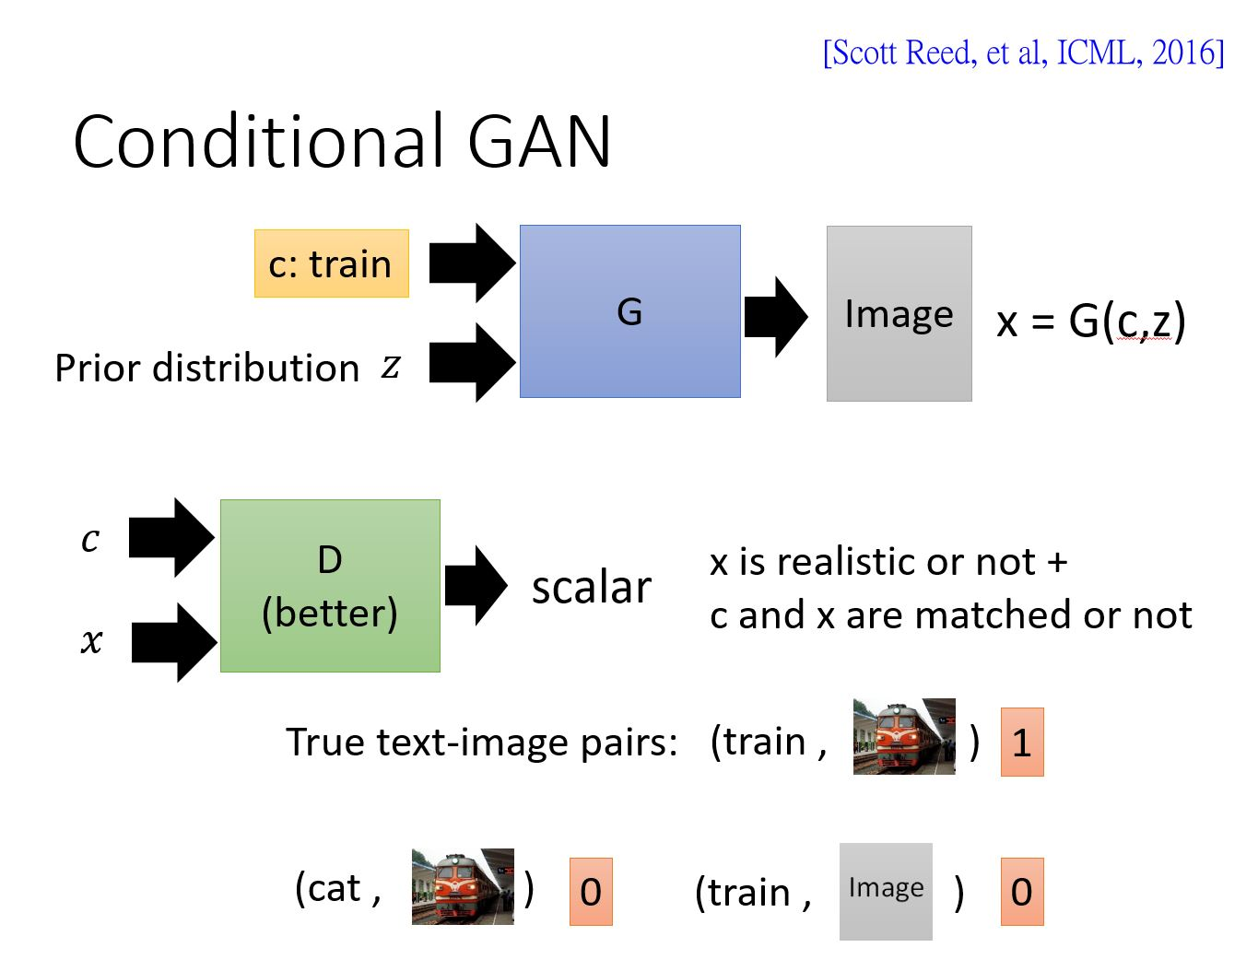
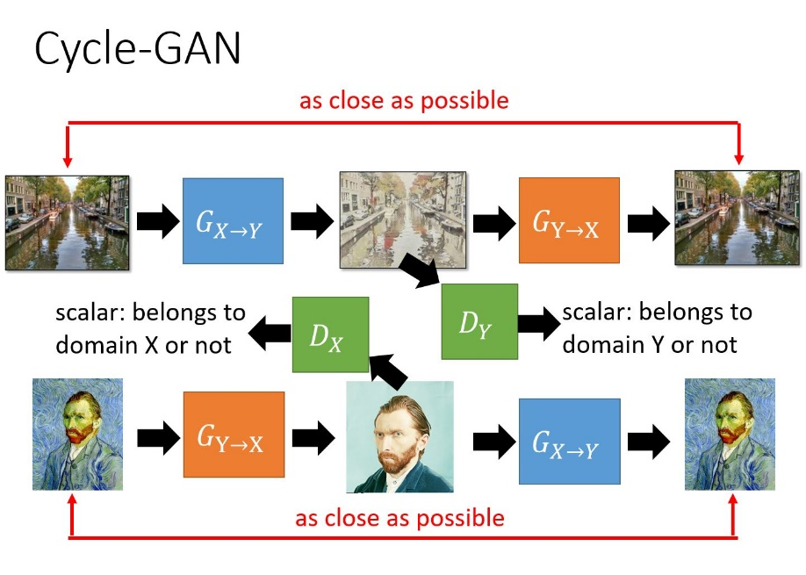
Speech Signal Generation (Regression Task)
Paired
Objective function
G
Output
Notes:
Speech signal generation is a regression task
The goal is to generate output speech that is close to the clean speech
In this tutorial, I am going to present some approaches that use conditional GAN and Cycle-GAN
Where GAN is used as a new objective function
Or, by GAN, we may not need paired training data
The conditional GAN and Cycle-GAN (that presented in Part-I) are used for this task

Slide 4
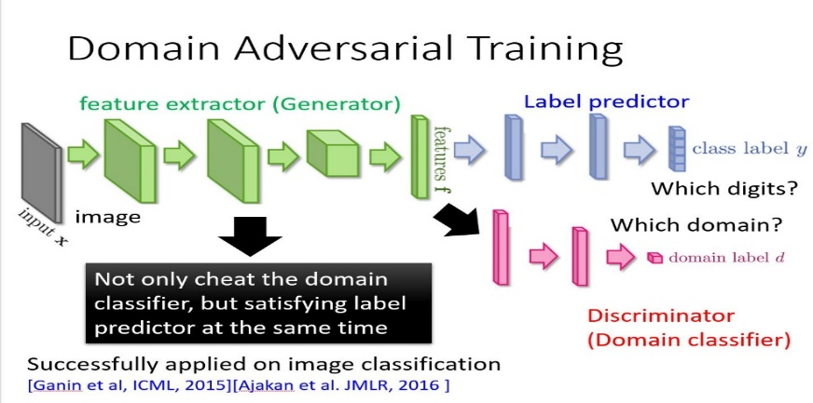








Speech, Speaker, Emotion Recognition and Lip-reading (Classification Task)
$$y$$
Output
label
G
$h(∙$)
$\tilde{z}=g(\tilde{x}$)
Emb.
E
$g(∙$)
Acoustic Mismatch
$$\hat{x}$$
$$\breve{x}$$
$$\tilde{x}$$
$$x$$
Channel distortion
Accented speech
Noisy data
Clean data
Notes:
Speech, Speaker, Emotion Recognition and Lip-reading are Classification Tasks
For the classification task, we train a classifier using training data
Usually, we test recognition on another domain
The acoustic mismatch of training and testing data may degrade the recognition performance
To address this issue, we prepare a small amount of adaptation data to adapt the classifier
Then we use the adapted classifier to test recognition using the test data
In this tutorial, I am going to review some approaches that use the domain adversarial training (introduced in Part-1) to perform model adaptation

Slide 5
Outline of Part II
Speech Signal Generation
Speech enhancement
Conclusion
Postfilter, speech synthesis, voice conversion
Speech recognition
Speech Signal Recognition
Speaker recognition
Speech emotion recognition
Lip reading
Notes:
OK, let me start to present some approaches using GAN for speech enhancement

Slide 6
Speech Enhancement
Enhancing
Typical objective function
Typical objective function
  Mean square error (MSE) [Xu et al., TASLP 2015], L1 [Pascual et al., Interspeech 2017], likelihood [Chai et al., MLSP 2017], STOI [Fu et al., TASLP 2018].
Objective function
G
Output
  Model structures of G: DNN [Wang et al. NIPS 2012; Xu et al., SPL 2014], DDAE
  [Lu et al., Interspeech 2013], RNN (LSTM) [Chen et al., Interspeech 2015;
  Weninger et al., LVA/ICA 2015], CNN [Fu et al., Interspeech 2016].
  GAN is used as a new objective function to estimate the parameters in G.
Notes:
The goal of speech enhancement is to transform noisy speech to clean speech
To attain higher intelligibility and quality
This is a typical speech enhancement system
We have a mapping function or generator G
The input of G is noisy speech
Then, G generates output speech
We used an objective function to measure the difference of the output speech and clean speech
Based on the objective function, we can update the parameters in G
Recently, many deep learning based models have been used as G
Such as DNN, DDAE, RNN (LSTM) and CNN
Meanwhile, there are several types of objective functions have been derived
Such as MSE, Maximum likelihood, L1 norm, and STOI
More recently, GAN is used for the objective function
The idea is that we don’t need to define an objective function
We directly train another model to judge whether the output is good enough or not

Slide 7
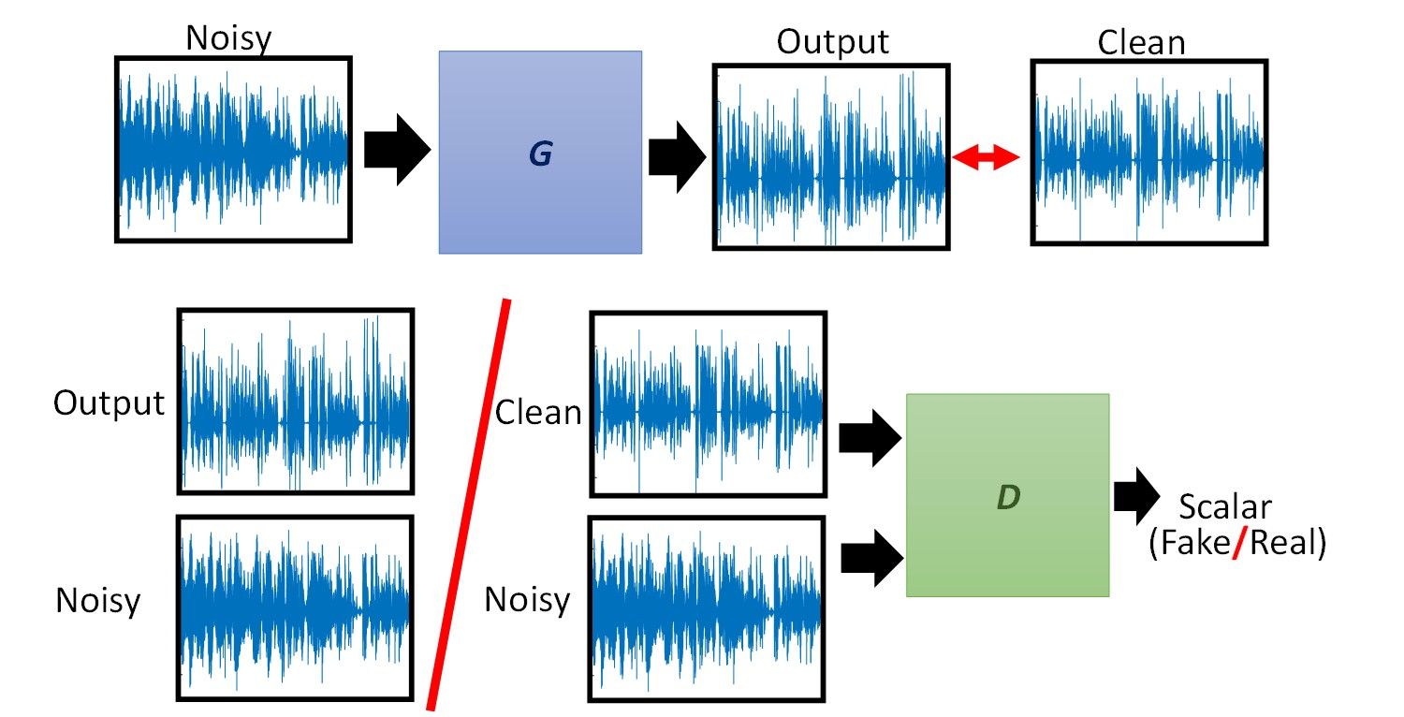
Speech Enhancement
Speech enhancement GAN (SEGAN) [Pascual et al., Interspeech 2017]
z
Notes:
This is a GAN-based speech enhancement system, SEGAN
The input of the generator is noisy speech waveform
Then G generates the output speech waveform
Instead of using an objective function to compute the difference of output and clean speech waveforms
We used a discriminator, D, to distinguish the output and clean speech waveforms
If D can easily discriminate the output and clean
Means that if the output is not good enough
then D will force G to update model parameters
After the parameters in G have been updated
Ｇcan generate better output
Then D has to become better
So that D can discriminate better output and clean speech waveforms
To attain better enhancement performance, the cost function of SEGAN is an combination of GAN loss and L1 loss
Because the system is based on the conditional GAN, we have an random noise input here
In the following discussion, we do not include z for simplicity
We also use the conditional noisy speech waveforms to train D

Slide 8
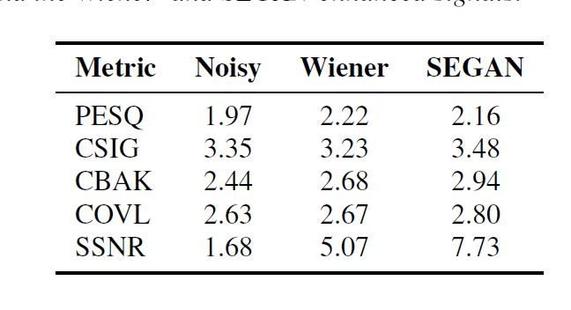
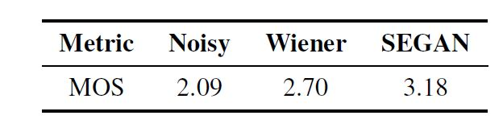
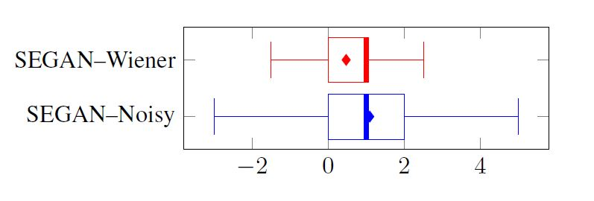
Speech Enhancement (SEGAN)
Experimental results
Table 1: Objective evaluation results.
Table 2: Subjective evaluation results.
Fig. 1: Preference test results.
SEGAN yields better speech enhancement results than Noisy and Wiener.
Notes:
The authors reported both objective and subjective evaluation results
For the objective results, SEGAN yields higher scores than noisy and Weiner filter
For the subjective listening results, SEGAN gives higher scores and better preference test results

Slide 9
Speech Enhancement
Pix2Pix [Michelsanti et al., Interpsech 2017]
Noisy
Output
Clean
G
Output
Clean
D
Scalar
(Fake/Real)
Noisy
Noisy
Notes:
This slide shows the pix2pix GAN-based speech enhancement approach
The system is very similar to SEGAN
The only difference is that the Pix2pix approach performs speech enhancement in the spectral domain
The input of G is noisy speech spectrogram
Then G generates the output speech spectrogram
The combination of output and noisy speech spectrogram is treated as the fake input
The combination of clean and noisy speech spectrogram is treated as the real input

Slide 10
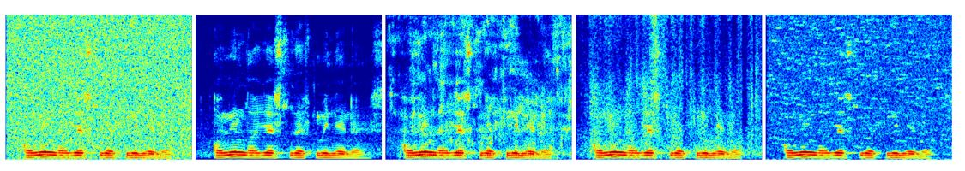
Speech Enhancement (Pix2Pix)
Spectrogram analysis
Fig. 2: Spectrogram comparison of Pix2Pix with baseline methods.
Noisy
Clean
NG-Pix2Pix
NG-DNN
STAT-MMSE
Pix2Pix outperforms STAT-MMSE and is competitive to DNN SE.
Notes:
The authors first compare the speech spectrograms of five systems
This one is the noisy speech spectrogram, this is the clean speech spectrogram
This is the speech spectrogram of Pox2pix
This is the speech spectrogram of DNN
This is the speech spectrogram of MMSE
From the results, we can see that the Pix2Pix outperforms STAT-MMSE and is competitive to DNN SE.

Slide 11
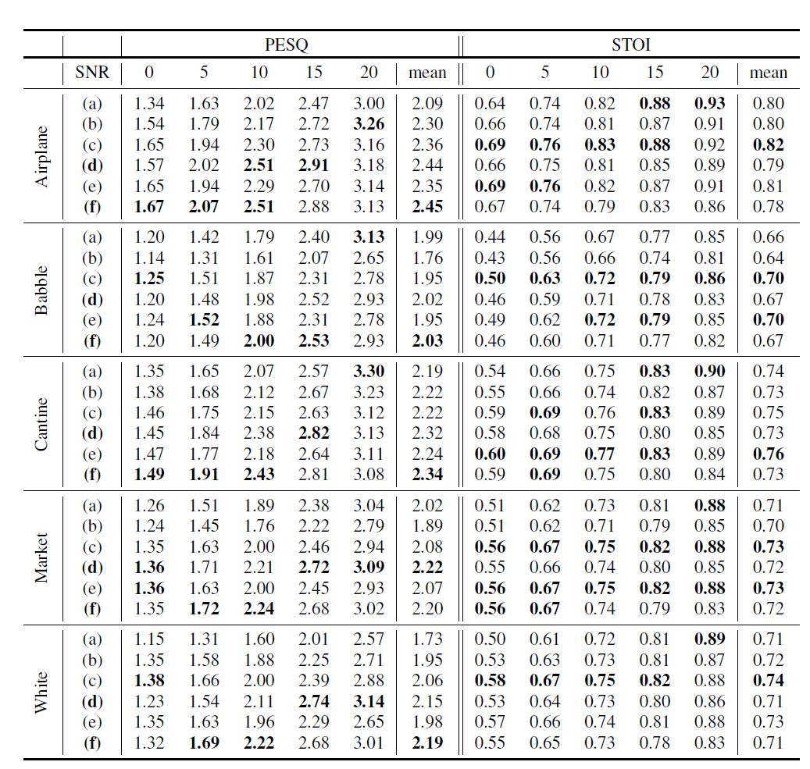
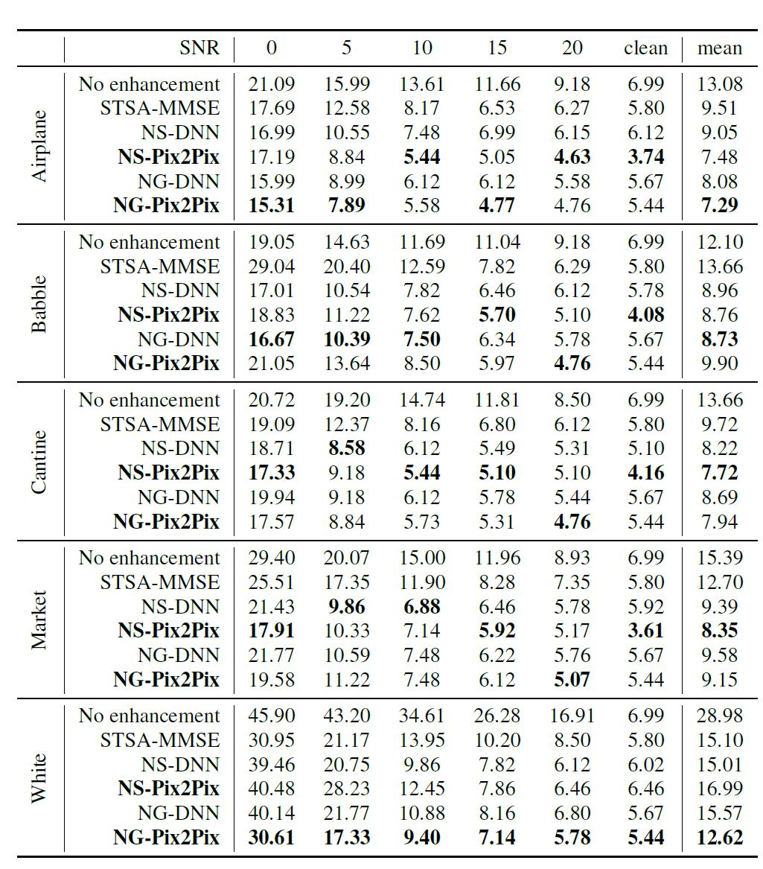
Speech Enhancement (Pix2Pix)
Objective evaluation and speaker verification test
Table 3: Objective evaluation results.
Table 4: Speaker verification results.
1. From the objective evaluations, Pix2Pix outperforms Noisy and
MMSE and is competitive to DNN SE.
2. From the speaker verification results, Pix2Pix outperforms the
baseline models when the clean training data is used.
Notes:
The authors also compares the speech signals using STOI and PESQ scores
A higher STOI score means better speech intelligibility
A higher PESQ score means better speech quality
The blue box is the NG-pix2pix approach
By comparing the original noisy signals without speech enhancement
We can see that the NG-pix2pix approach outperforms noisy signals without speech enhancement
Also, the NG-pix2pix approach outperforms STAT-MMSE
Finally, we noted that the NG-pix2pix approach is comparable to DNN-based speech enhancement
The paper also adopts the denoising approach as the front-end process for a speaker verification task
The results are reported in equal error rate
A lower EER means better verification performance
The verification results are similar to the objective results
The Pix2Pix approach is better than original noisy speech and STAT-MMSE
While is comparable to DNN approach
EER scores

Slide 12
Speech Enhancement
Frequency-domain SEGAN (FSEGAN) [Donahue et al., ICASSP 2018]
Noisy
Output
Clean
G
Output
Clean
D
Scalar
(Fake/Real)
Noisy
Noisy
Notes:
In the ICASP this year, a FSEGAN speech enhancement approach has been proposed
Ｔhe system is very similar to the pix2pix approach
While they use this system as a front-end for noise robust ASR task

Slide 13
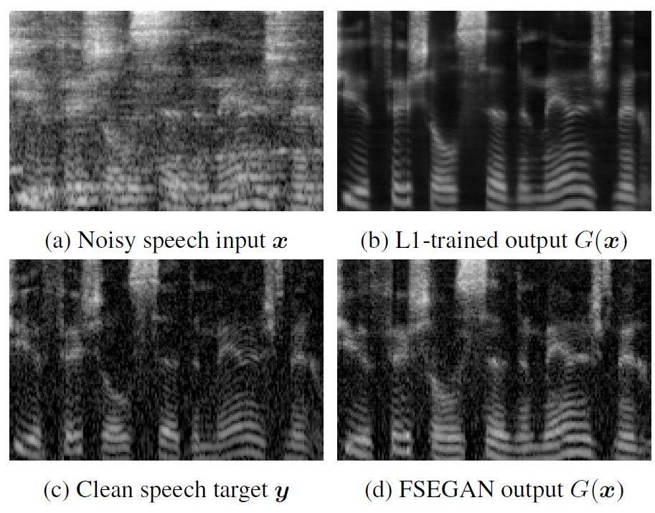
Speech Enhancement (FSEGAN)
Spectrogram analysis
Fig. 2: Spectrogram comparison of FSEGAN with L1-trained method.
FSEGAN reduces both additive noise and reverberant smearing.
Notes:
The authors compared the results of using L1 and GAN for the objective function
This is noisy speech spectrogram, clean speech spectrogram, L1 and GAN enhanced speech spectrogram
From these four spectrograms, we can see that the proposed FSEGAN generates similar spectrogram to clean speech spectrogram

Slide 14
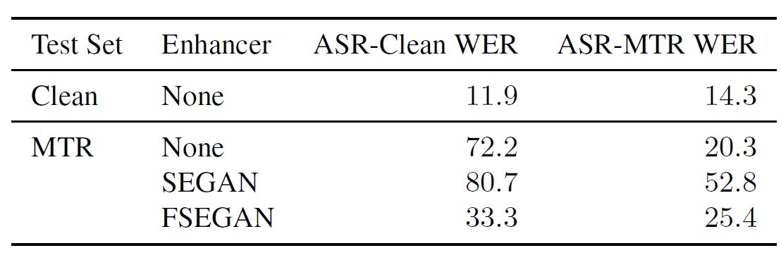
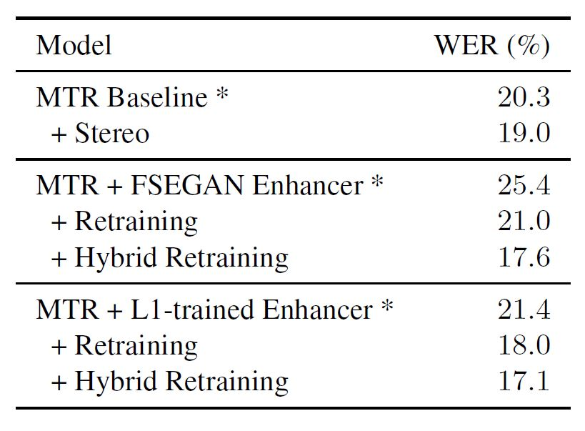
Speech Enhancement (FSEGAN)
ASR results
Table 5: WER (%) of SEGAN and FSEGAN.
Table 6: WER (%) of FSEGAN with retrain.
1. From Table 5, (1) FSEGAN improves recognition results for ASR-Clean.
(2) FSEGAN outperforms SEGAN as front-ends.
2. From Table 6, (1) Hybrid Retraining with FSEGAN outperforms Baseline;
(2) FSEGAN retraining slightly underperforms L1–based retraining.
Notes:
Table 5 shows the recognition results of using SEGAN and FSEGAN as the front-end
The authors also use SEGAN and FSEGAN to process the training data
and the processed speech data are used to retrain the acoustic models
The results of retrained acoustic models are listed in Table 6
From the results in Table 6, we can see that Hybrid Retraining with FSEGAN outperforms Baseline
However L1–based retraining outperforms FSEGAN–based retraining
So the conclusion here is GAN for speech enhancement is good and can be used as a front-end for speech recognition and speaker recognition
However, it still has room for further improvement

Slide 15
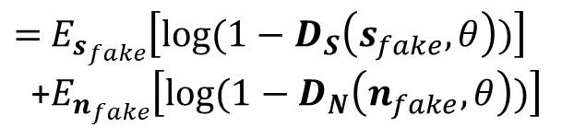

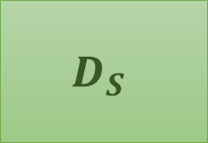
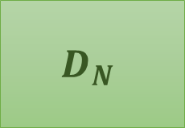

Speech Enhancement
Adversarial training based mask estimation (ATME) [Higuchi et al., ASRU 2017]
True or Fake
True or Fake
$$D_{S}$$
$$D_{N}$$
or
or
True noise
True speech
Estimated speech
Estimated noise
Noise data
Clean speech data
$$G_{Mask}$$
$$V_{Mask}$$
Noisy speech
$=$ $E_{s_{fake}}\left[log⁡(1−D_{S}\left(s_{fake},θ\right))\right]$
+$E_{n_{fake}}\left[log⁡(1−D_{N}\left(n_{fake},θ\right))\right]$
Noisy data
Notes:
Another GAN-based mask estimation system is proposed In ASRU 2017,
The system has two discriminators,
one is to distinguish true noise and estimated noise
Another discriminator is to distinguish true speech and estimated speech
The objective function of the mask estimator is to generate the speech and noise
To cheat these two discriminators
Please note that, because these two Ds can be trained separately
This approach does not require paired training data

Slide 16
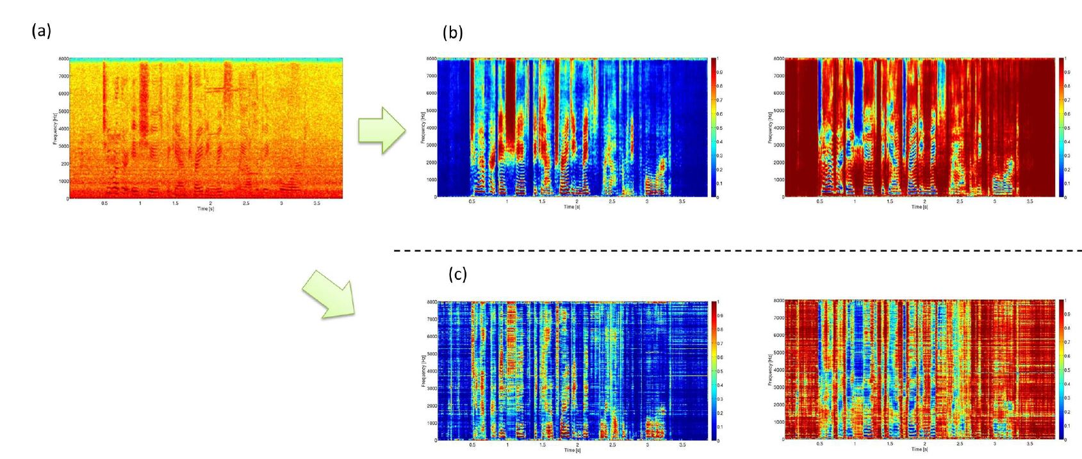

Speech Enhancement (ATME)
Spectrogram analysis
Fig. 3: Spectrogram comparison of (a) noisy; (b) MMSE with supervision; (c) ATMB without supervision.
Speech mask
Noise mask
$$M_{f,t}^{\left(n\right)}$$
The proposed adversarial training mask estimation can capture speech/noise signals without supervised data.
Notes:
This slide shows the spectrograms of speech mask and noise mask
These two spectrograms are the spectrograms for the speech mask
And these two spectrograms are the spectrograms for the noise mask
The top two spectrograms are estimated by supervised data
That means during training, the true clean speech and true noise were given to train the mask generator
From the results of these four spectrograms,
we can note that the proposed adversarial training can effectively capture speech and noise signals
However, the authors did not directly use the estimated speech signal for speech recognition
Instead, they use the estimated noise mask for a mask-based beamformer

Slide 17
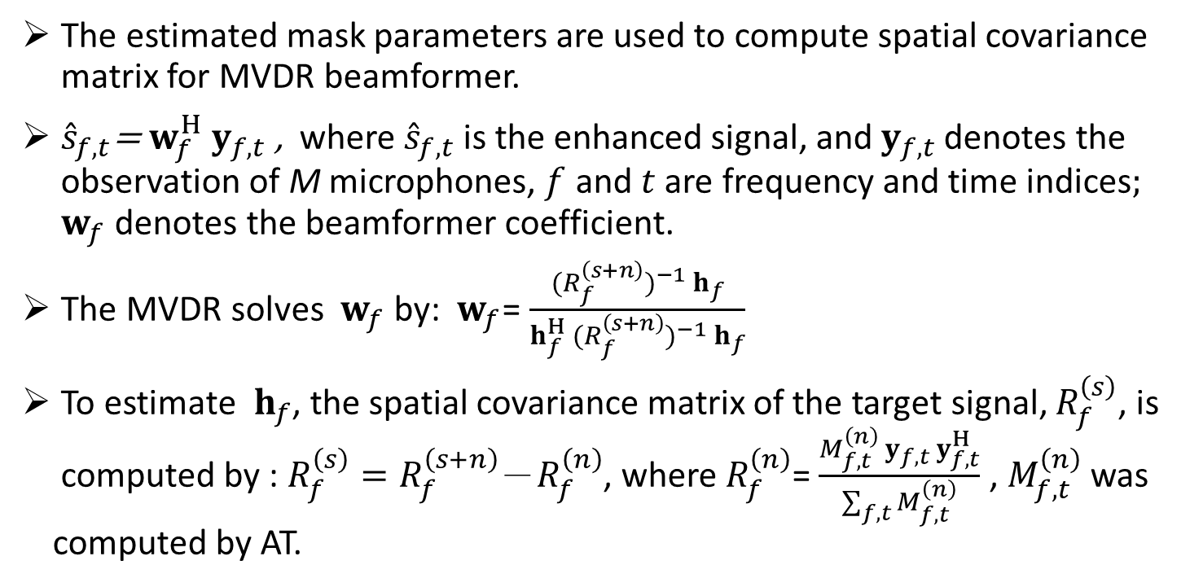
Speech Enhancement (ATME)
Mask-based beamformer for robust ASR
The estimated mask parameters are used to compute spatial covariance
matrix for MVDR beamformer.
${\hat{s}}_{f,t}$= $w_{f}^{H}{ y}_{f,t}$ , where ${\hat{s}}_{f,t}$ is the enhanced signal, and${ y}_{f,t}$ denotes the
observation of M microphones, $f$ and $t$ are frequency and time indices; ${ w}_{f}$ denotes the beamformer coefficient.
The MVDR solves ${ w}_{f}$ by: ${ w}_{f}$= $\frac{{{(R_{f}^{\left(s+n\right)})}^{−1} h}_{f}}{h_{f}^{H} {(R_{f}^{\left(s+n\right)})}^{−1}{ h}_{f}}$
To estimate ${ h}_{f}$, the spatial covariance matrix of the target signal, $R_{f}^{\left(s\right)}$, is
computed by : $R_{f}^{\left(s\right)}=R_{f}^{\left(s+n\right)}$－$R_{f}^{\left(n\right)}$, where $R_{f}^{\left(n\right)}$= $\frac{{M_{f,t}^{\left(n\right)} y}_{f,t} y_{f,t}^{H}}{\sum_{f,t}{M_{f,t}^{\left(n\right)}}}$ , $M_{f,t}^{\left(n\right)}$ was computed by AT.
Notes:
The estimated noise makes is used with the MVDR beamformer
When we have multiple signal inputs y
We need to estimate a weight vector, which consists of beamformer coefficients
We use the MVDR to compute this coefficient vector
For the MVDR algorithm, we need to have the steering vector h
To compute h, we need to have the spatial covariance matrix
IT is not easy to directly compute the spatial covariance matrix, so the estimated mask is used here
Based on the estimated mask, we can compute this
Then, we can get spatial contrivance matrix of target signal
Then, we can compute h
And w
And finally, we can get the enhanced speech signal s

Slide 18
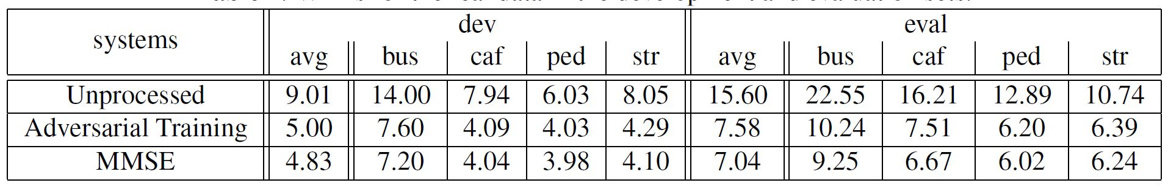
Speech Enhancement (ATME)
ASR results
Table 7: WERs (%) for the development and evaluation sets.
1. ATME provides significant improvements over Unprocessed.
2. Unsupervised ATME slightly underperforms supervised MMSE.
Notes:
The ASR results are listed here
Comparing with unprocessed signals, the proposed adversarial training approach yields significant recognition improvements
Comparing with the supervised version, when paired speech and noise are provided, the proposed method also gives comparable results

Slide 19
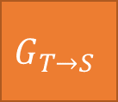
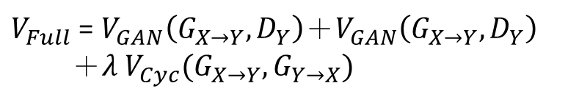
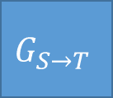


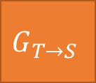

Speech Enhancement (AFT)
Cycle-GAN-based acoustic feature transformation (AFT) [Mimura et al., ASRU 2017]
as close as possible
Clean
Syn. Noisy
Clean
$$G_{S→T}$$
$$G_{T→S}$$
Scalar: belongs to domain S or not
$$D_{S}$$
$$D_{T}$$
Scalar: belongs to domain T or not
$$G_{T→S}$$
$$G_{S→T}$$
Noisy
Enhanced
Noisy
as close as possible
$V_{Full}$ = $V_{GAN}\left(G_{X→Y},D_{Y}\right)＋V_{GAN}\left(G_{X→Y},D_{Y}\right)$
$＋λ{ V}_{Cyc}(G_{X→Y},G_{Y→X})$
Notes:
This is another GAN-based speech enhancement system
The system is actually based on the cycle-GAN
For the top row, the clean speech is first converted to synthesized noisy speech
And then transformed back to the clean speech
For the bottom raw, the noisy speech is first converted to enhanced speech
And then transformed to the noisy speech
Then the consistency loss is applied to make sure these two and these two are as close as possible
Moreover, there are two mode discriminators, this aims to make the synthesized noisy speech to be close to the real noisy speech
And this is to make the enhanced speech to be close to the clean speech
From this system, we can use this enhanced speech as front-end processing for ASR
We can also use this synthesized noisy speech to adapt the acoustic models

Slide 20
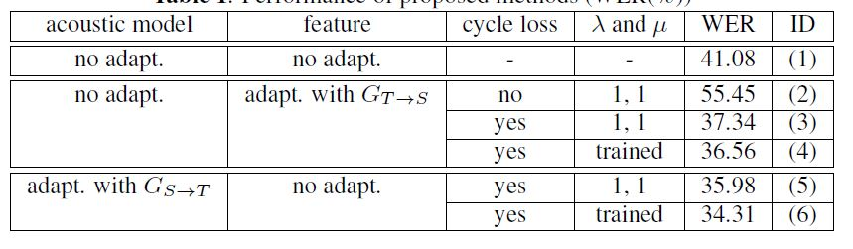
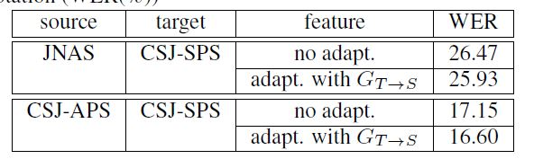

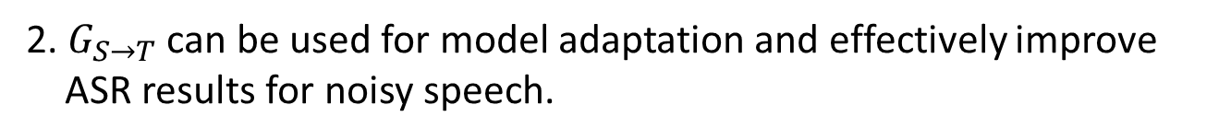
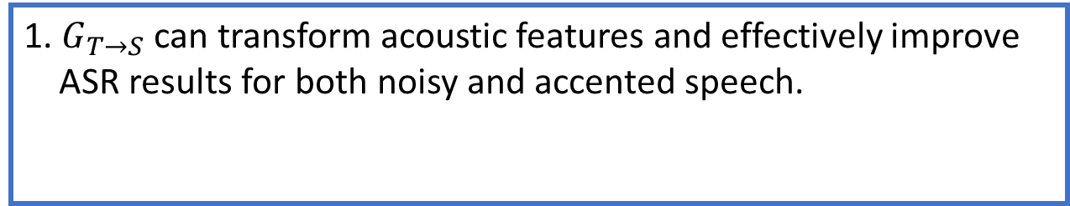
Speech Enhancement (AFT)
ASR results on noise robustness and style adaptation
Table 8: Noise robust ASR.
Table 9: Speaker style adaptation.
S: Clean; $T$: Noisy
JNAS: Read; CSJ-SPS: Spontaneous (relax);
CSJ-APS: Spontaneous (formal);
1. $G_{T→S}$ can transform acoustic features and effectively improve
ASR results for both noisy and accented speech.
2. $G_{S→T}$ can be used for model adaptation and effectively improve
ASR results for noisy speech.
Notes:
The cycle-GAN based speech enhancement was tested on two ASR tasks
One is noise robustness
The other is speaker style adaptation
From the results, we can note that $G_{T→S}$ feature transformation can improve recognition results for both noisy and style adaptation ASR tasks
We also noted that $G_{S→T}$ can be used for model adaptation to improve ASR results in noisy conditions

Slide 21
Outline of Part II
Speech Signal Generation
Speech enhancement
Conclusion
Postfilter, speech synthesis, voice conversion
Speech recognition
Speech Signal Recognition
Speaker recognition
Speech emotion recognition
Lip reading
Notes:
Next, I am going to present GAN for postfilter, speech synthesis, and voice conversion
Again the conditional GAN and Cycle-GAN are widely used for these tasks

Slide 22
Postfilter
Postfilter for synthesized or transformed speech
  Conventional postfilter approaches for G estimation include global variance (GV) [Toda et al., IEICE 2007], variance scaling (VS) [Sil’en et al., Interpseech 2012], modulation spectrum (MS) [Takamichi et al., ICASSP 2014],DNN with MSE criterion [Chen et al., Interspeech 2014; Chen et al., TASLP 2015].
  GAN is used a new objective function to estimate the parameters in G.
Natural
spectral texture
Speech synthesizer
Synthesized spectral texture
Objective function
Voice
conversion
G
Output
Speech
enhancement
Notes:
First, let me briefly introduce the post-filter task
The post-filter task uses a mapping function, G, to convert synthesized speech to the one that is similar to natural speech
An objective function is used to judge the difference of generated speech and natural speech
In the past, many algorithms have been used to design the mapping function
Similar to speech enhancement, GAN is also used as an objective function to compute the parameters of the mapping function, G

Slide 23
Postfilter
GAN postfilter [Kaneko et al., ICASSP 2017]
  Traditional MMSE criterion results in statistical averaging.
  GAN is used as a new objective function to estimate the parameters in G.
  The proposed work intends to further improve the naturalness of
  synthesized speech or parameters from a synthesizer.
Natural
Mel cepst. coef.
Synthesized
Mel cepst. coef.
Generated
Mel cepst. coef.
Nature
or
Generated
G
D
Notes:
This plot is a GAN-based post-filter system
The input of the mapping function, G, is the synthesized speech,
The output is the generated speech
The discriminator is trained with the aim to distinguish the generated and natural spectral features
In here, they used the low-resolution feature: mel cepstral coefficients
Traditional MSE-based objective function suffers over-smoothing problem
Based on GAN, the naturalness of the generated speech can be further improved

Slide 24
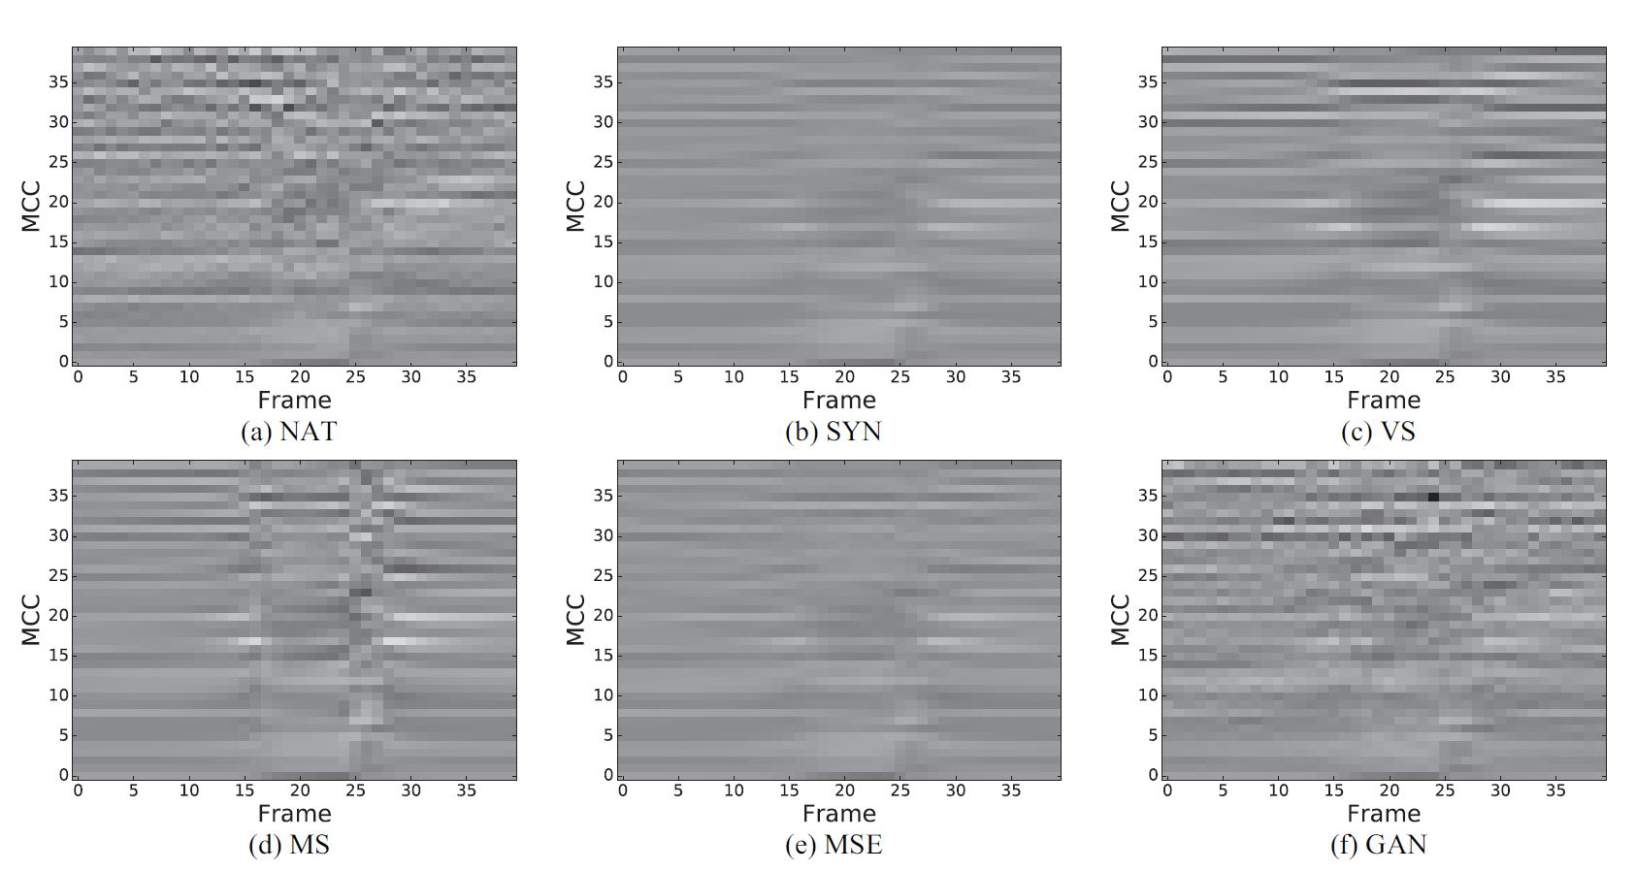
Postfilter (GAN-based Postfilter)
Spectrogram analysis
Fig. 4: Spectrograms of: (a) NAT (nature); (b) SYN (synthesized); (c) VS (variance scaling); (d) MS (modulation spectrum); (e) MSE; (f) GAN postfilters.
GAN postfilter reconstructs spectral texture similar to the natural one.
Notes:
The authors listed the spectrograms of natural speech and several well-known post-filter approaches
The result of GAN is shown here
From the spectrograms, we can note that GAN generates spectral texture similar to the natural one

Slide 25
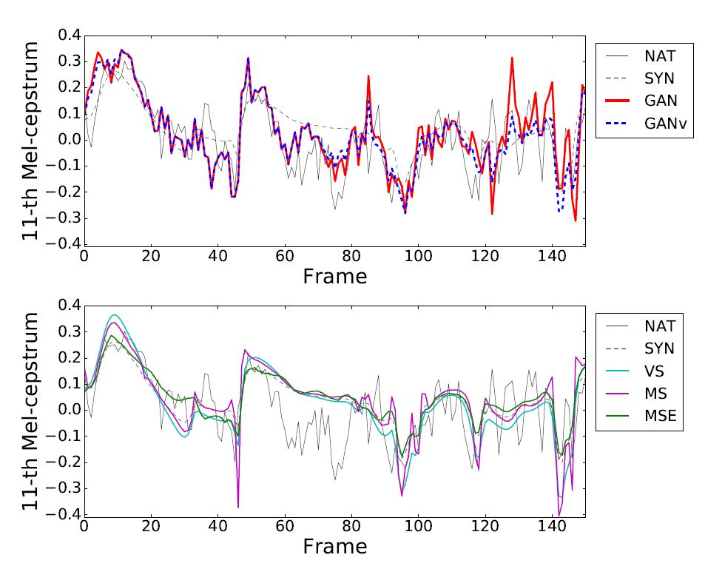
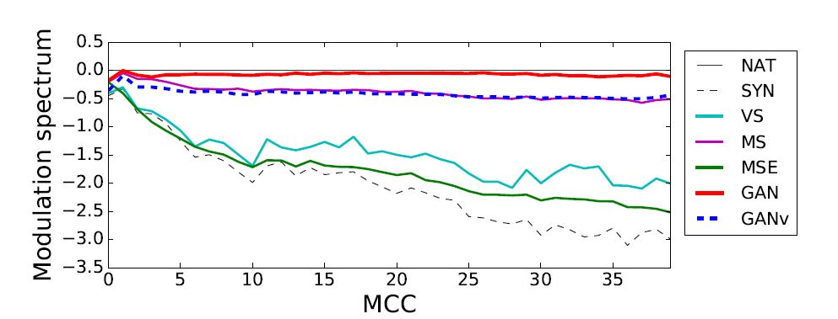
Postfilter (GAN-based Postfilter)
Objective evaluations
Fig. 6: Averaging difference in modulation spectrum per Mel-cepstral coefficient.
Fig. 5: Mel-cepstral trajectories (GANv: GAN was applied in voiced part).
GAN postfilter reconstructs spectral texture similar to the natural one.
Notes:
The objective evaluations in terms of Feature trajectory and modulation spectrum
Here, the authors proposed an improved version of GAN-based post-filter, GANv
Where the GAN-based post-filter is only applied in voice segments
The objective results show that
Both GAN and GANv always outperform conventional approaches

Slide 26
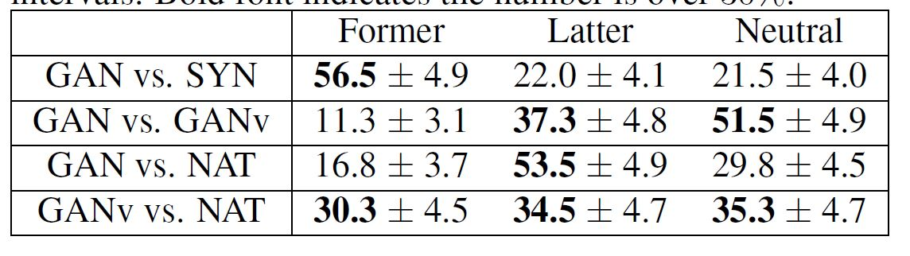
Postfilter (GAN-based Postfilter)
Subjective evaluations
Table 10: Preference score (%). Bold font indicates the numbers over 30%.
1. GAN postfilter significantly improves the synthesized speech.
2. GAN postfilter is effective particularly in voiced segments.
3. GANv outperforms GAN and is comparable to NAT.
Notes:
They have also conducted subjective listening tests
The results show that
GAN clearly outperforms synthesized speech
And GANv provides further improvements over GAN
Moreover, GANv yields comparable scores to natural speech

Slide 27
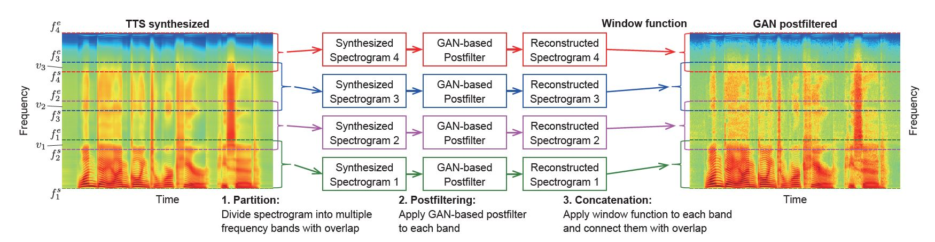
Postfilter (GAN-postfilter-SFTF)
GAN post-filter for STFT spectrograms [Kaneko et al., Interspeech 2017]
  GAN postfilter was applied on high-dimensional STFT spectrograms.
  The spectrogram was partitioned into N bands (each band overlaps its
  neighboring bands).
  The GAN-based postfilter was trained for each band.
  The reconstructed spectrogram from each band was smoothly connected.
Notes:
Later on the same group has proposed another work
Before, the applied GAN-based post-filter on mel cepstrum coefficient
In this work, the authors applied GAN-based post-filter on STFT spectgroams (which is the higher resolution feature)
In stead of working on every frequency bin, they first partition the spectrgromas into N subbands
The GAN-based post-filter is applied on each subband individually
Finally, these N bands are combined to reconstruct the output spectrogram

Slide 28
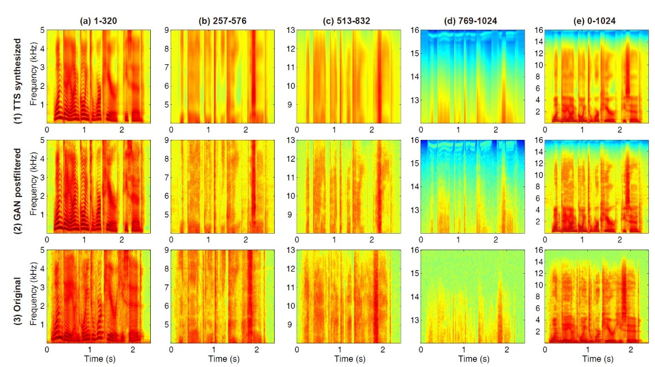
Postfilter (GAN-postfilter-SFTF)
Spectrogram analysis
Fig. 7: Spectrograms of: (1) SYN, (2) GAN, (3) Original (NAT)
GAN postfilter reconstructs spectral texture similar to the natural one.
Notes:
They used four subbands in their experiment
The spectrograms of each sub-bands are listed in column one, two, three, and four
Corresponding to lower frequency region, middle frequency regions, and high frequency region
The final column is the combination of these four subbands
From the spectrogram comparison, we can note that GAN-based post-filter can generate spectral texture that is similar to the natural spectral texture

Slide 29


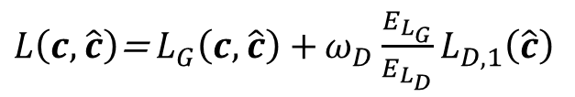
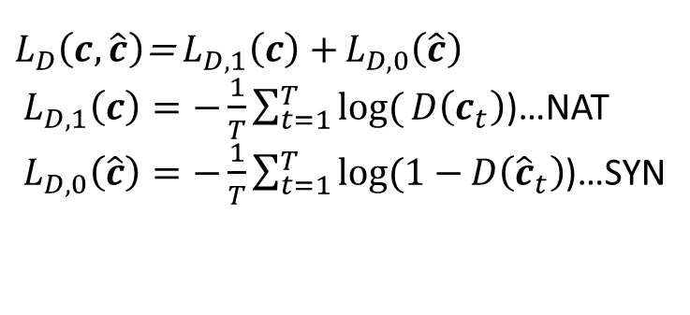



Speech Synthesis
Input: linguistic features; Output: speech parameters
Speech synthesis with anti-spoofing verification (ASV) [Saito et al., ICASSP 2017]
$$c$$
$$\hat{c}$$
$$c$$
$$\hat{c}$$
Generated speech
parameters
Generated speech
parameters
Natural speech
parameters
$${ G}_{SS}$$
Natural speech
parameters
$${ G}_{SS}$$
Objective function
Linguistic
features
MGE
Linguistic
features
Minimum generation error (MGE), MSE
sp
sp
sp
sp
$L\left(c,\hat{c}\right)$=${ L}_{G}\left(c,\hat{c}\right)+ω_{D}\frac{E_{L_{G}}}{E_{L_{D}}}L_{D,1}\left(\hat{c}\right)$
Minimum generation error (MGE) with adversarial loss.
$$φ(∙)$$
$${ D}_{ASV}$$
Gen.
Nature
$L_{D}\left(c,\hat{c}\right)$=${ L}_{D,1}\left(c\right)+L_{D,0}\left(\hat{c}\right)$
${ L}_{D,1}\left(c\right)=−\frac{1}{T}\sum_{t=1}^{T}{log(}D\left(c_{t}\right)$)…NAT
${ L}_{D,0}\left(\hat{c}\right)=−\frac{1}{T}\sum_{t=1}^{T}{log(1−}D\left({\hat{c}}_{t}\right)$)…SYN
Notes:
GAN is also used to improve the speech synthesis system
In a speech synthesis system
The input is the linguist feature, and G generates speech parameters, such as mel cepstral coefficeitns, f0, duration,
Traditional speech synthesis system uses one objective function to compute the difference of generated speech parameters and the natural speech parameters
Minimum generation error and MSE are two common objective functions
Ｂy optimizing the objective function, we can then update the parameters in the generator
This is a work combining a speech synthesis module with an anti-spoofing verification module
So, here we call it the ASV approach
This part is speech synthesis
The input is linguist features and the output is the generated speech parameters
The objective function for the synthesis module is a combination of Minimum generation error and this term
Which forces the synthesizer to generate more natural speech to cheat the ASV module
This anti-spoofing verification module is used to distinguish generated speech parameters and natural speech parameters
The speech parameters here is the mel cepstram coefficient

Slide 30
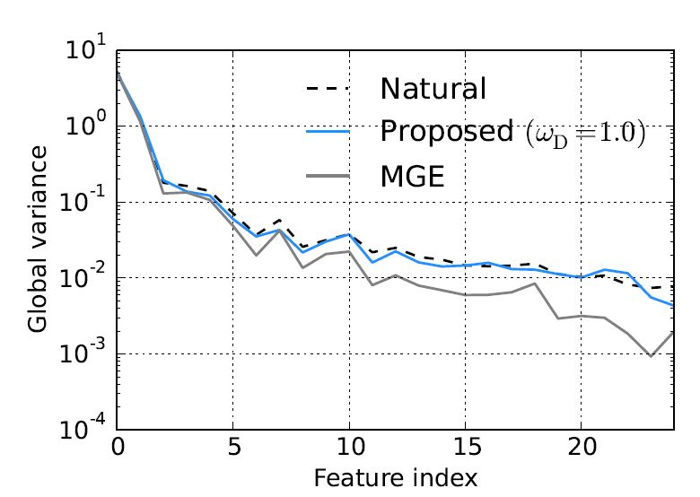
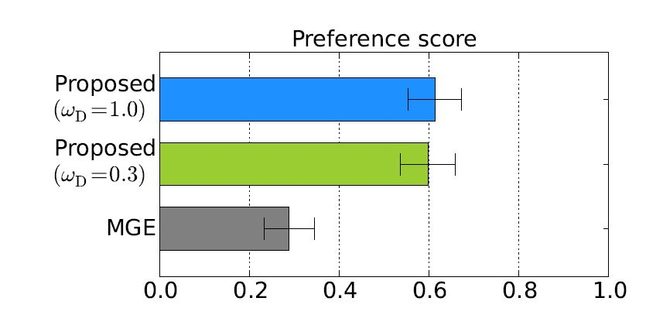
Speech Synthesis (ASV)
Objective and subjective evaluations
Fig. 8: Averaged GVs of MCCs.
Fig. 9: Scores of speech quality.
1. The proposed algorithm generates MCCs similar to the natural ones.
2. The proposed algorithm outperforms conventional MGE training.
Notes:
The authors show the results of both objective and subjective evaluations
For the objective evaluation, they have compared the global variance of different features
The results show that the proposed ASV approach outperforms the MGE approach
And is comparable to the natural speech
For the subjective listening test
The results show that the proposed approach outperforms MGE training with different parameter setups

Slide 31

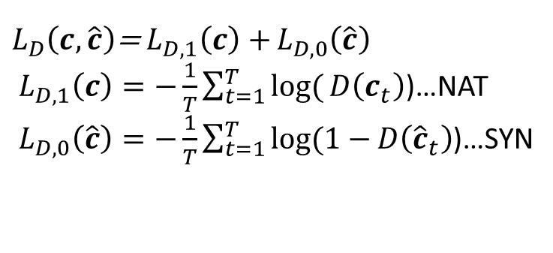




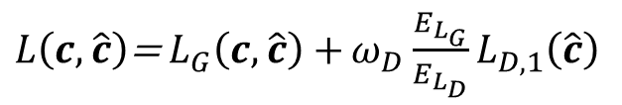

Speech Synthesis
Speech synthesis with GAN (SS-GAN) [Saito et al., TASLP 2018]
$$\hat{c}$$
$$c$$
$${ G}_{SS}$$
Generated speech
parameters
Natural speech
parameters
Linguistic
features
MGE
sp, f0, duration
sp, f0, duration
$L\left(c,\hat{c}\right)$=${ L}_{G}\left(c,\hat{c}\right)+ω_{D}\frac{E_{L_{G}}}{E_{L_{D}}}L_{D,1}\left(\hat{c}\right)$
$${ D}_{ASV}$$
Minimum generation error (MGE) with adversarial loss.
$$φ(∙)$$
$$D$$
Gen.
Nature
$L_{D}\left(c,\hat{c}\right)$=${ L}_{D,1}\left(c\right)+L_{D,0}\left(\hat{c}\right)$
${ L}_{D,1}\left(c\right)=−\frac{1}{T}\sum_{t=1}^{T}{log(}D\left(c_{t}\right)$)…NAT
${ L}_{D,0}\left(\hat{c}\right)=−\frac{1}{T}\sum_{t=1}^{T}{log(1−}D\left({\hat{c}}_{t}\right)$)…SYN
Notes:
Let us look at the ASV system again
It is not easy to tell that the system is very similar to a GAN system
So later on, the same group rename their system with SS-GAN
And they also tried to apply this system to different speech parameters
In addition to the mel cepstral coefficients, they also tried f0 and duration coeffiecincts

Slide 32
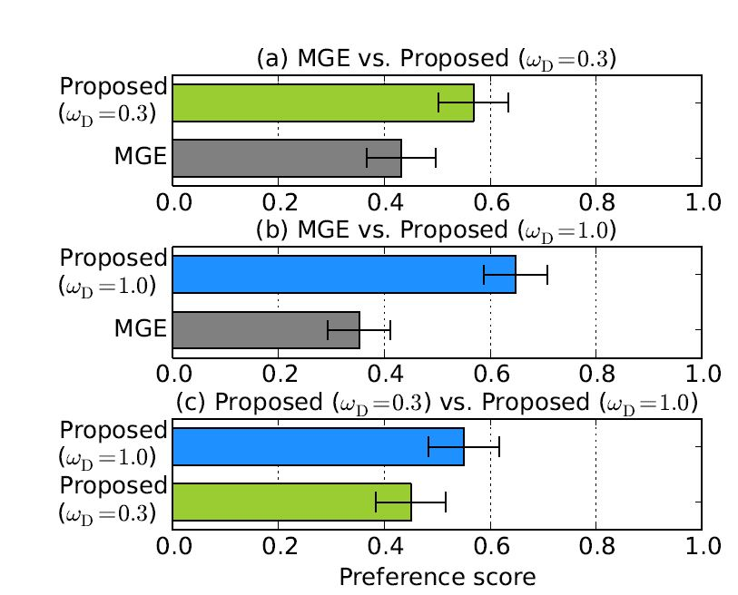
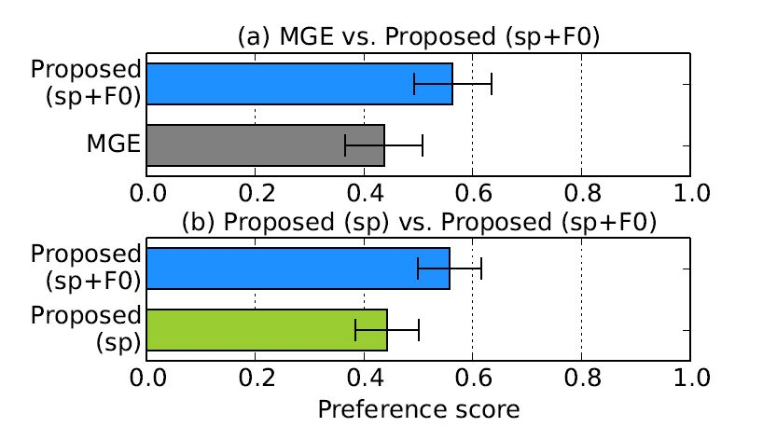
Speech Synthesis (SS-GAN)
Subjective evaluations
Fig. 10: Scores of speech quality (sp).
Fig. 11: Scores of speech quality (sp and F0).
The proposed algorithm works for both spectral parameters and F0.
.
Notes:
Here is the results of subjective listening scores,
For the generation of spectral features
the proposed approach outperforms conventional MGE training
First, they tested GAN for MCCs and F0
The results show that the GAN-based approach performs better
Then they compared with f0 and without f0, and the results show that with f0 performs better
In conclusion, the proposed approach works well for both spectral features and F0 parameters

Slide 33

Speech Synthesis
Speech synthesis with GAN glottal waveform model (GlottGAN) [Bollepalli et al., Interspeech 2017]
Glottal waveform
Glottal waveform
G
Generated speech
parameters
Natural speech
parameters
Acoustic
features
$$D$$
Gen.
Nature
Notes:
Glottal waveform is another speech parameters that is often used in speech synthesis
This plot shows a GAN-based speech synthesis system to generate more natural glottal waveforms
The input of generator is acoustic features
And the output is glottal waveforms
D here aims to distinguish generated and natural glottal waveforms

Slide 34
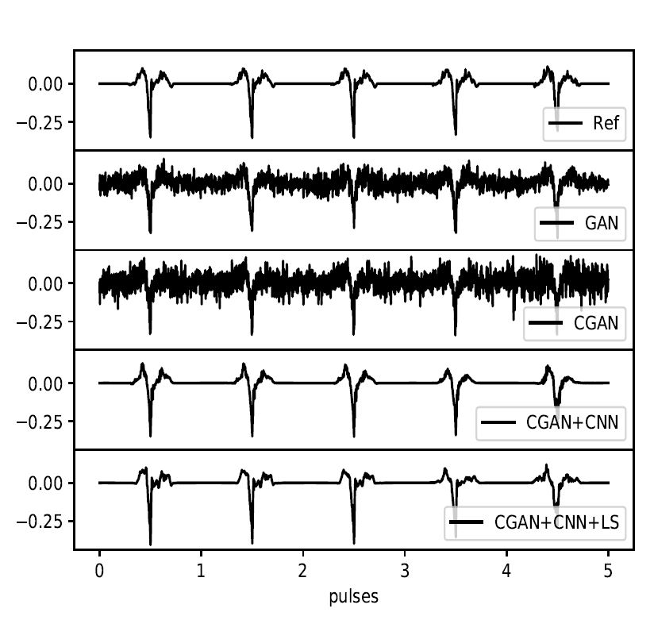
Speech Synthesis (GlottGAN)
Objective evaluations
Fig. 12: Glottal pulses generated by GANs.
G, D: DNN
G, D: conditional DNN
G, D: Deep CNN
G, D: Deep CNN + LS loss
The proposed GAN-based approach can generate glottal waveforms similar to the natural ones.
Notes:
The authors have compared the GAN-based system with different model architectures
Including using DNN for both G and D
Conditional DNN for both G and D
Deep CNN for G and D
Deep CNN for G and D and with the least square loss
The results show that the Deep CNN with LS loss performs the best and
The generated glottal waveforms are more similar to the natural one

Slide 35




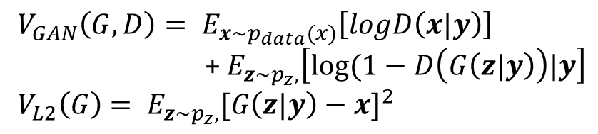


Speech Synthesis
Speech synthesis with GAN & multi-task learning (SS-GAN-MTL) [Yang et al., ASRU 2017]
$$\hat{x}$$
$$x$$
$$z$$
Generated speech
parameters
Natural speech
parameters
$${ G}_{SS}$$
MSE
Noise
$$D$$
Gen.
$$y$$
Nature
Linguistic
features
$V_{GAN}\left(G,D\right)= E_{x\sim p_{data}(x)}\left[logD\left(x|y\right)\right]$
+ $E_{z\sim p_{z},}\left[log⁡(1−D\left(G\left(z|y\right)\right)|y\right]$
$V_{L2}\left(G\right)$ $= E_{z\sim p_{z},}{[G\left(z|y\right)−x]}^{2}$
Notes:
In ASRU 2017, another GAN-based speech synthesis approach has been proposed
The difference of their work and Saito’s work is that
They claim the input should be random noise
While the linguist features are used as condition both for the speech synthesizer and discriminator
This could be more similar to the setup of conditional GAN
To train the synthesizer, the objective function is formed by combining MSE and adversarial loss

Slide 36





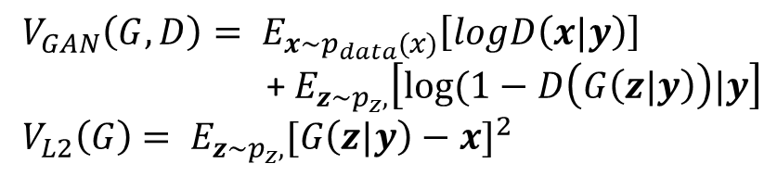








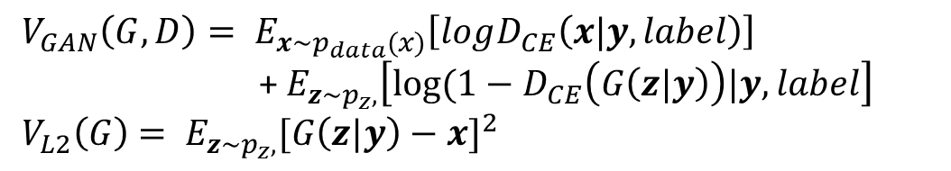
Speech Synthesis (SS-GAN-MTL)
Speech synthesis with GAN & multi-task learning (SS-GAN-MTL) [Yang et al., ASRU 2017]
$$\hat{x}$$
$$\hat{x}$$
$$x$$
$$x$$
$$z$$
$$z$$
Generated speech
parameters
Generated speech
parameters
Natural speech
parameters
$${ G}_{SS}$$
Natural speech
parameters
$${ G}_{SS}$$
MSE
MSE
Noise
Noise
$${ D}_{CE}$$
$${ D}_{CE}$$
Gen.
$$D$$
Gen.
CE
$$y$$
Nature
$$y$$
Nature
Linguistic
features
Linguistic
features
True label
$V_{GAN}\left(G,D\right)= E_{x\sim p_{data}(x)}\left[logD_{CE}\left(x|y,label\right)\right]$
+ $E_{z\sim p_{z},}\left[log⁡(1−D_{CE}\left(G\left(z|y\right)\right)|y,label\right]$
$V_{L2}\left(G\right)$ $= E_{z\sim p_{z},}{[G\left(z|y\right)−x]}^{2}$
$V_{GAN}\left(G,D\right)= E_{x\sim p_{data}(x)}\left[logD\left(x|y\right)\right]$
+ $E_{z\sim p_{z},}\left[log⁡(1−D\left(G\left(z|y\right)\right)|y\right]$
$V_{L2}\left(G\right)$ $= E_{z\sim p_{z},}{[G\left(z|y\right)−x]}^{2}$
Notes:
Moreover, they have proposed a new loss function to replace the original loss function of the discriminator
Original loss function is to determine the generated and natural speech by setting one and zero
The new discriminator is a phone classifier
The output of D is a phone recognition vector
If the input is real speech parameters, the recognition vector should be close to the true label
When the input is generated speech parameters, then the recognition vector should be different from the true lalbes
Based on such D and C, we can improve G

Slide 37
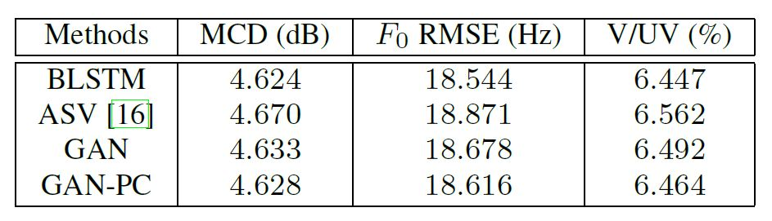
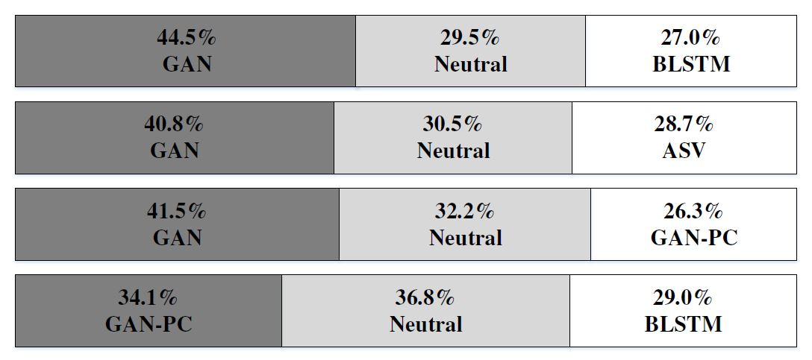
Speech Synthesis (SS-GAN-MTL)
Objective and subjective evaluations
Table 11: Objective evaluation results.
Fig. 13: The preference score (%).
1. From objective evaluations, no remarkable difference is observed.
2. From subjective evaluations, GAN outperforms BLSTM and ASV,
while GAN-PC underperforms GAN.
Notes:
The authors present the objective and subject evaluation results
They have compared their systems with BLSTM and ASV systems
The results showed that the proposed methods and the BLSTM and ASV approaches are similar in terms of objective evaluations
From the subjective evaluation results, we can note that
GAN outperforms BLSTM and ASV
Unfortunately the phone-based classifier could not give further improvements over GAN

Slide 38


Voice Conversion
Convert (transform) speech from source to target
  Conventional VC approaches include Gaussian mixture model (GMM) [Toda
  et al., TASLP 2007], non-negative matrix factorization (NMF) [Wu et al., TASLP
  2014; Fu et al., TBME 2017], locally linear embedding (LLE) [Wu et al.,
  Interspeech 2016], restricted Boltzmann machine (RBM) [Chen et al., TASLP
  2014], feed forward NN [Desai et al., TASLP 2010], recurrent NN (RNN)
  [Nakashika et al., Interspeech 2014].
Target speaker
Source speaker
Objective function
G
Output
Notes:
Next, Ｉ am going to present GAN-based voice conversion
The overall process of voice conversion is very similar to speech enhancement
A mapping function, G, is used to convert speech from source speaker to target speaker
In the past, many approaches have been proposed for voice conversion

Slide 39



Voice Conversion
VAW-GAN [Hsu et al., Interspeech 2017]
  Conventional MMSE approaches often encounter the “over-smoothing” issue.
  GAN is used a new objective function to estimate G.
  The goal is to increase the naturalness, clarity, similarity of converted speech.
Target speaker
Source speaker
Real
or
Fake
G
D
$$V\left(G,D\right)=V_{GAN}\left(G,D\right)+λV_{VAE}\left(x|y\right)$$
Notes:
Traditionally, many approaches use the MMSE criterion to estimate the parameters in G
However, using the MMSE criterion usually results in the over-smoothing issue
Recently, GAN has been widely used as a new objective function to estimate G
The goal is to increase the naturalness, clarity, and similarity of converted speech
This figure shows the work of VAW-GAN
For the generator, the input is speech of the source speaker
The output is the speech of the target speaker
The discriminator is to distinguish whether the input is real or converted speech

Slide 40
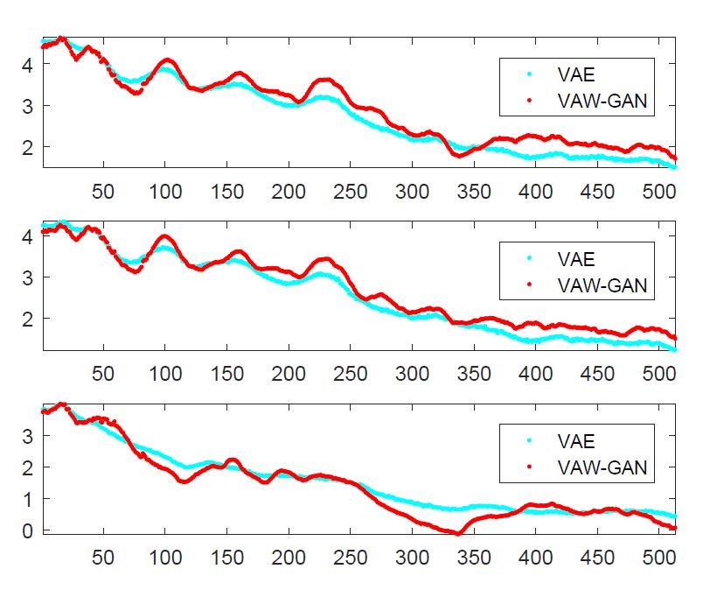

Voice Conversion (VAW-GAN)
Objective and subjective evaluations
Fig. 14: The spectral envelopes.
Fig. 15: MOS on naturalness.
VAW-GAN outperforms VAE in terms of objective and subjective evaluations with generating more structured speech.
Notes:
This is the results they show in the paper
The objective results show that the VAW-GAN has clearer structures, more peaks and valleys
The MOS results also showed that VAW-GAN outperforms VAE for both intra-gender and inter-gender conditions

Slide 41





Voice Conversion
Sequence-to-sequence VC with learned similarity metric (LSM) [Kaneko et al., Interspeech 2017]
Target speaker
$$y$$
Source speaker
Real
or
Fake
$$C$$
D
$$z$$
$$G$$
Noise
Similarity metric
$V_{SVC}^{D_{l}}\left(C,D\right)$=$\frac{1}{M_{l}}{\left\|D_{l}\left(y\right)−D_{l}\left(C(x\right))\right\|}^{2}$
$$V\left(C, G,D\right)=V_{SVC}^{D_{l}}\left(C,D\right)+V_{GAN}(C,G,D)$$
Notes:
This plot shows another GAN-based VC
The authors argue that the we don not need to design an objective function to estimate the difference of speech signals
Instead, we can estimate the difference in a hidden layer in the discriminator
In this way, we can compare the signals in a more abstract domain
Moreover, they have combined the traditional voice conversion with GAN in this way
So the D needs to distinguish the speech of the real target speech, converted speech, and generated speech

Slide 42

Voice Conversion (LSM)
Spectrogram analysis
Fig. 16: Comparison of MCCs (upper) and STFT spectrograms (lower).
Source
Target
FVC
MSE(S2S)
LSM(S2S)
The spectral textures of LSM are more similar to the target ones.
Notes:
The conversion is performed in the Mel cepstral coefficient domain
The top figures are the MCC spectrogram
And lower figures are the STFT spectrogram
We can note clear over-smoothing results in these two figures
We can also note that the spectral texture from the proposed LSM is similar to the target one

Slide 43



Voice Conversion (LSM)
Subjective evaluations
Table 12: Preference scores for naturalness.
Fig. 17: Similarity of TGT and SRC with VCs.
Table 12: Preference scores for clarity.
Target speaker
Source speaker
LSM outperforms FVC and MSE in terms of subjective evaluations.
Notes:
The authors also conducted subjective listening tests
Here are the preference tests of naturalness and clarity
From the results, the proposed method are notably better than conventional frame-based VC and MSE-based sequence-to-sequence approach
For the voice conversion task, it is important that the converted speech sound differently to the source speaker
While sound similarly to the target speaker
So, the authors have conducted the similarity listening tests
The results show that the proposed method achieve better similarity scores than conventional approaches
Again verify the effectiveness of the proposed approach

Slide 44







Voice Conversion
CycleGAN-VC [Kaneko et al., arXiv 2017]
used a new objective function to estimate G
as close as possible
Source
Syn. Target
Source
$$G_{S→T}$$
$$G_{T→S}$$
Scalar: belongs to domain S or not
$$D_{S}$$
$$D_{T}$$
Scalar: belongs to domain T or not
$$G_{T→S}$$
$$G_{S→T}$$
Target
Syn. Source
Target
as close as possible
$V_{Full}$ = $V_{GAN}\left(G_{X→Y},D_{Y}\right)＋V_{GAN}\left(G_{X→Y},D_{Y}\right)$
$＋λ{ V}_{Cyc}(G_{X→Y},G_{Y→X})$
Notes:
This is a cycleGAN based VC system
For the top row, G converts source speech to target speech
Then another G converts the target speech again back to the source speech
One goal is to minimize the difference of these two source speech signals
A D is used here to make the converted speech to be more natural and similar to the target speech
Similarly In the bottom row, a G is used here to convert the target speech to source speech
Another G is used to convert the source speech to the target speech
There is another D, which tries to make the converted speech to be more natural and similar to the source speech

Slide 45


Voice Conversion (CycleGAN-VC)
Subjective evaluations
Fig. 19: Similarity of to source and to target speakers. S: Source; T:Target; P: Proposed; B:Baseline
Fig. 18: MOS for naturalness.
Target speaker
Source speaker
1. The proposed method uses non-parallel data.
2. For naturalness, the proposed method outperforms baseline.
3. For similarity, the proposed method is comparable to the baseline.
Notes:
The authors have reported the subjective listening tests
The results in terms of MOS sow that the proposed approach outperforms the baseline GMM system
They also conducted the similarity test
And the results show that the proposed approach outperforms the baseline GMM-based system
Baseline: GMM
Synth: synthesized-and-analyzed

Slide 46















Voice Conversion
Multi-target VC [Chou et al., arxiv 2018]
Stage-1
C
$$y$$
$E$nc
Dec
···
$$enc(x)$$
$$x$$
$$dec(enc\left(x\right),y)$$
$$dec(enc\left(x\right),y′)$$
$$y$$
$y′$····
Stage-2
$$y"$$
$E$nc
Dec
$$enc(x)$$
F/R
$$x$$
D+C
$$G$$
ID
Real
data
$$y"$$
Notes:
More recently a multi-target VC has been proposed
There are two stages in the system
In the first stage, we have an encoder, a decoder, and a classifier
The input of the encoder is source speech
And the encoder generates code vector
The classifier is trained to maximize the speaker ID output
While minimize the speaker information in the code vector
Then, given the target speaker code, the decoder will generate the speech of the target speaker
In stage-2, this part is fixed
While another GAN is used to improve the converted speech
Additionally, the a classifier is used with D
So this unit, (D+C) not only distinguish real and fake speech
But also force G to maximize the speaker information in the generated speech

Slide 47

Voice Conversion (Multi-target VC)
Subjective evaluations
Fig. 20: Preference test results
1. The proposed method uses non-parallel data.
2. The multi-target VC approach outperforms one-stage only.
3. The multi-target VC approach is comparable to Cycle-GAN-VC in
terms of the naturalness and the similarity.
Notes:
The multi-target VC uses non-parallel data
And the results show the effectiveness of the two stage or 1 stage
The results also show that the multi-target approach is comparable to Cycle-GAN-VC in
terms of the naturalness and the similarity.

Slide 48
Outline of Part II
Speech Signal Generation
Speech enhancement
Conclusion
Postfilter, speech synthesis, voice conversion
Speech recognition
Speech Signal Recognition
Speaker recognition
Speech emotion recognition
Lip reading
Notes:
Next, I am going to present the second part of part II
That is GAN for speech signal recognition

Slide 49
Speech, Speaker, Emotion Recognition and Lip-reading (Classification Task)
$$y$$
Output
label
G
$h(∙$)
$\tilde{z}=g(\tilde{x}$)
Emb.
E
$g(∙$)
Acoustic Mismatch
$$\hat{x}$$
$$\breve{x}$$
$$\tilde{x}$$
$$x$$
Channel distortion
Accented speech
Noisy data
Clean data
Notes:
As motioned earlier, I am going to review some approaches that use the domain adversarial training to perform model adaptation

Slide 50











Speech Recognition
Adversarial multi-task learning (AMT)
[Shinohara Interspeech 2016]
$$y$$
Objective function
$$z$$
Output 1 Senone
Output 2 Domain
$V_{y}$=$−\sum_{i}{log⁡P(y_{i}|x_{i};θ_{E},θ_{G})}$
$V_{z}$=$−\sum_{i}{log⁡P(z_{i}|x_{i};θ_{E},θ_{D})}$
G
D
$$V_{y}$$
$$V_{z}$$
Model update
$$θ_{G}←θ_{G}−ϵ\frac{∂V_{y}}{∂θ_{G}}$$
Max classification accuracy
GRL
$$θ_{D}←θ_{D}−ϵ\frac{∂V_{z}}{∂θ_{D}}$$
Max domain accuracy
E
$$θ_{E}←θ_{E}−ϵ\left(\frac{∂V_{y}}{∂θ_{G}}\right)$$
$$+α\frac{∂V_{z}}{∂θ_{G}}$$
Input
Acoustic feature
Max classification accuracy
$$x$$
and Min domain accuracy
Notes:
This is the standard flowchart of the ASR training
The input is acoustic feature vectors , and the output is senone vectors
The loss function is V_{y}
Based on this loss, the parameters in G and E are updated to maximize the classification accuracy
In the adversarial training framework
We have another network D, and we have another loss function
Based on this function, the parameters in D are updated to maximize the domain accuracy
Here, the GRL: gradient reversal layer is used
E is trained to maximize the recognition accuracy and minimize the domain discrimination
So the recognition will be less sensitive or invariant to the domain information

Slide 51

Speech Recognition (AMT)
ASR results in known (k) and unknown (unk) noisy conditions
Table 13: WER of DNNs with single-task learning (ST) and AMT.
The AMT-DNN outperforms ST-DNN with yielding lower WERs.
Notes:
This table shows the WERs of DNNs with two types of training criteria
Single task and adversarial multi-task training
From the results, we can easily note that the adversarial multitask training outperforms single task training
with giving lower WERs

Slide 52





Speech Recognition
Domain adversarial training for accented ASR (DAT)
[Sun et al., ICASSP2018]
$$y$$
Objective function
$$z$$
Output 1 Senone
Output 2 Domain
$V_{y}$=$−\sum_{i}{log⁡P(y_{i}|x_{i};θ_{E},θ_{G})}$
$V_{z}$=$−\sum_{i}{log⁡P(z_{i}|x_{i};θ_{E},θ_{D})}$
G
D
$$V_{y}$$
$$V_{z}$$
Model update
$$θ_{G}←θ_{G}−ϵ\frac{∂V_{y}}{∂θ_{G}}$$
Max classification accuracy
GRL
E
$$θ_{D}←θ_{D}−ϵ\frac{∂V_{z}}{∂θ_{D}}$$
Max domain accuracy
$$θ_{E}←θ_{E}−ϵ\left(\frac{∂V_{y}}{∂θ_{G}}\right)$$
$$+α\frac{∂V_{z}}{∂θ_{G}}$$
Input
Acoustic feature
Max classification accuracy
$$x$$
and Min domain accuracy
Notes:
The same system has been used in the accented ASR task
Based on this domain adversarial training
The recognizer become less sensitive to domain information
Here is accented

Slide 53

Speech Recognition (DAT)
ASR results on accented speech
Table 14: WER of the baseline and adapted model.
STD: standard speech
1. With labeled transcriptions, ASR performance notably improves.
2. DAT is effective in learning features invariant to domain differences
with and without labeled transcriptions.
Notes:
The authors have conducted ASR on accented speech
STD means standard speech
From the results, we can note that with domain adversarial training, the WER has been significantly reduced
The authors also tried unsupervised adaptation
Where the adaptation data does not have labeled transcriptions
The results how that DAT is effective in learning features invariant to domain differences with and without labeled transcriptions.

Slide 54










Speech Recognition
Robust ASR using GAN enhancer (GAN-Enhancer) [Sriram et al., arXiv 2017]
$$y$$
Output
label
Cross entropy with L1 Enhancer:
L1
$$H\left(h\left(\tilde{z}\right),y\right)+λ\frac{{\left\|z−\tilde{z}\right\|}_{1}}{{\left\|z\right\|}_{1}+{\left\|\tilde{z}\right\|}_{1}+ε}$$
D
G
$h(∙$)
$z=g(x$)
$\tilde{z}=g(\tilde{x}$)
Emb.
Emb.
E
E
$g(∙$)
$g(∙$)
Cross entropy with GAN Enhancer:
$H\left(h\left(\tilde{z}\right),y\right)+λ{ V}_{adv}$($g(x$) , $g(\tilde{x}$))
$$x$$
$$\tilde{x}$$
Noisy data
Clean data
Notes:
From a different point of view
If we have data from two domains
And we have the same encoder
We want to force the code vectors of these two domains as close as possible
We can incorporate a constraint during training, such as the L1 norm, to force these two code vectors to be close
The objective function to update the parameters in the recognizer is like this
In this work, a GAN-enhancer is proposed which places D here to distinguish the code vectors of clean and noisy speech

Slide 55

Speech Recognition (GAN-Enhancer)
ASR results on far-field speech:
Fig. 15: WER of GAN enhancer and the baseline methods.
GAN Enhancer outperforms the Augmentation and L1-Enhancer approaches on far-field speech.
Notes:
This table shows the WER results in a far field speech recognition task
We can note that GAN enhancer can provide notable recognition improvements over conventional approaches
And L1 enhancer

Slide 56
Outline of Part II
Speech Signal Generation
Speech enhancement
Conclusion
Postfilter, speech synthesis, voice conversion
Speech recognition
Speech Signal Recognition
Speaker recognition
Speech emotion recognition
Lip reading
Notes:
Next, I am going to review an approach of GAN for speaker recognition

Slide 57





Speaker Recognition
Domain adversarial neural network (DANN)
[Wang et al., ICASSP 2018]
$$y$$
Output 1 Speaker ID
$$z$$
Output 2 Domain
G
D
$$V_{y}$$
$$V_{z}$$
Enroll
i-vector
GRL
DANN
Pre-processing
E
Scoring
DANN
Pre-processing
Test
i-vector
$$x$$
Input
Acoustic feature
Notes:
The system is similar to speech recognition
The input is the I-vector
And the output is the speaker label
And here, we have another output, which is the domain label
Based on the domain adversarial training, the code vector is less sensitive to the domain variations
And the encoder is used here, and the code vector is used to perform speaker verification
The pre-processing here is signal whitening and normalization
And the scoring is based on the PLDDA model

Slide 58

Speaker Recognition (DANN)
Recognition results of domain mismatched conditions
Table 16: Performance of DAT and the state-of-the-art methods.
The DAT approach outperforms other methods with achieving lowest EER and DCF scores.
Notes:
The authors have reported the EER and DCF scores
They also compared the proposed system with various related works
And the results show that the proposed DAT outperforms conventional approaches

Slide 59
Outline of Part II
Speech Signal Generation
Speech enhancement
Conclusion
Postfilter, speech synthesis, voice conversion
Speech recognition
Speech Signal Recognition
Speaker recognition
Speech emotion recognition
Lip reading
Notes:
Next, I am going to present GAN for speech emotion recognition

Slide 60









Emotion Recognition
Adversarial AE for emotion recognition (AAE-ER)
[Sahu et al., Interspeech 2017]
$$x$$
AE with GAN :
$H\left(h\left(z\right),x\right)+λ{ V}_{GAN}$($q$, $g(x$))
D
G
$h(∙$)
$$q$$
$z=g(x$)
Emb.
Syn.
E
$g(∙$)
The distribution of code vectors
$$x$$
Notes:
This is an autoencoder model
Both the input and output is acoustic features
In this work, we can define some distributions
And D is used to force the code vectors to have the same distributions to the defined distribution
In this work, they have defined distributions of four emotions, including angry, sad, neural, and happy
Accordingly each code vector is a two dimensional vector
The results show that in the two-D space, the four emotions are clearly separated

Slide 61



Emotion Recognition (AAE-ER)
Recognition results of domain mismatched conditions:
Table 17: Classification results on different systems.
Table 18: Classification results on real and synthesized features.
Original
Training data
1. AAE alone could not yield performance improvements.
2. Using synthetic data from AAE can yield higher UAR.
Notes:
Based on the code vectors, we conducted the emotion recognition task
The results show that using the 2-D code vector, we can achieve similar recognition results to the original system,
which uses a high-dimensional vector
The results also show that the 2-D vector outperforms several traditional approaches
The authors further used the AAE system to synthesize training data
The results show that by combining the original training data with synthesized training data,
we can obtain better emotion recognition results

Slide 62
Outline of Part II
Speech Signal Generation
Speech enhancement
Conclusion
Postfilter, speech synthesis, voice conversion
Speech recognition
Speech Signal Recognition
Speaker recognition
Speech emotion recognition
Lip reading
Notes:
Next, I am going to present GAN for lip reading

Slide 63












Lip-reading
Domain adversarial training for lip-reading (DAT-LR) [Wand et al., arXiv 2017]
$$y$$
Objective function
$$z$$
Output 1 Words
Output 2 Speaker
$V_{y}$=$−\sum_{i}{log⁡P(y_{i}|x_{i};θ_{E},θ_{G})}$
$V_{z}$=$−\sum_{i}{log⁡P(z_{i}|x_{i};θ_{E},θ_{D})}$
G
D
Model update
$$V_{y}$$
$$V_{z}$$
$$θ_{G}←θ_{G}−ϵ\frac{∂V_{y}}{∂θ_{G}}$$
Max classification accuracy
GRL
$$θ_{D}←θ_{D}−ϵ\frac{∂V_{z}}{∂θ_{D}}$$
Max domain accuracy
E
$$θ_{E}←θ_{E}−ϵ\left(\frac{∂V_{y}}{∂θ_{G}}\right)$$
$$+α\frac{∂V_{z}}{∂θ_{G}}$$
Max classification accuracy
$$x$$
and Min domain accuracy
~80% WAC
Notes:
In a lip-reading system, the input is the video of the speaker and the output is word
If we train and testing recognition with the same speaker
The recognition can be around 80 % word accuracy
However, if a new speaker tried to use the system, the recognition accuracy will be significantly reduced
Here, the same domain adversarial training can be used to adapt the model
And thus to minimize the speaker information

Slide 64

Lip-reading (DAT-LR)
Recognition results of speaker mismatched conditions
Table 19: Performance of DAT and the baseline.
The DAT approach notably enhances the recognition accuracies in different conditions.
Notes:
The results are listed here
The top is the baseline, where no adaptation is applied
As you can see, without adaptation, the word accuracy is very low 18.7 %
If we train the recognizer with data from more speakers, then we can get some performance improvements
When we apply the domain adversarial training, we note that the recognition results in different systems are all improved
Finally, since the authors test the adaptation performance using less data
The results are listed here
The results show that the DAT system still outperforms the baseline among different systems
The results confirm the effectiveness of DAT for model adaptation for the lip-reading system

Slide 65
Outline of Part II
Speech Signal Generation
Speech enhancement
Conclusion
Postfilter, speech synthesis, voice conversion
Speech recognition
Speech Signal Recognition
Speaker recognition
Speech emotion recognition
Lip reading
Notes:
Next, I am going to provide conclusion remarks

Slide 66
Speech Signal Generation (Regression Task)
Paired
Objective function
G
Output
Notes:
Speech signal generation is a regression task
The goal is to generate output speech that is close to the clean speech
In this tutorial, I am going to present some approaches that use conditional GAN and Cycle-GAN
Where GAN is used as a new objective function
Or, by GAN, we may not need paired training data
The conditional GAN and Cycle-GAN (that presented in Part-I) are used for this task

Slide 67
Speech, Speaker, Emotion Recognition and Lip-reading (Classification Task)
$$y$$
Output
label
G
$h(∙$)
$\tilde{z}=g(\tilde{x}$)
Emb.
E
$g(∙$)
Acoustic Mismatch
$$\hat{x}$$
$$\breve{x}$$
$$\tilde{x}$$
$$x$$
Channel distortion
Accented speech
Noisy data
Clean data
Notes:
Speech, Speaker, Emotion Recognition and Lip-reading are Classification Tasks
For the classification task, we train a classifier using training data
Usually, we test recognition on another domain
The acoustic mismatch of training and testing data may degrade the recognition performance
To address this issue, we prepare a small amount of adaptation data to adapt the classifier
Then we use the adapted classifier to test recognition using the test data
For this task, the domain adversarial training (introduced in Part-1) to perform model adaptation

Slide 68
More GANs in Speech
Diagnosis of autism spectrum
Jun Deng, Nicholas Cummins, Maximilian Schmitt, Kun Qian, Fabien Ringeval, and Björn Schuller, Speech-based Diagnosis of Autism Spectrum Condition by Generative Adversarial Network Representations, ACM DH, 2017.
Emotion recognition
Jonathan Chang, and Stefan Scherer, Learning Representations of Emotional Speech with Deep Convolutional Generative Adversarial Networks, ICASSP, 2017.
Robust ASR
Dmitriy Serdyuk, Kartik Audhkhasi, Philémon Brakel, Bhuvana Ramabhadran, Samuel Thomas, and Yoshua Bengio, Invariant Representations for Noisy Speech Recognition, arXiv, 2016.
Speaker verification
Hong Yu, Zheng-Hua Tan, Zhanyu Ma, and Jun Guo, Adversarial Network Bottleneck Features for Noise Robust Speaker Verification, arXiv, 2017.
Notes:
Due to the limitation of time, I did not review all the papers of GAN-based signal processing
Here are some more related works

Slide 69
References
Speech enhancement (conventional methods)
Yuxuan Wang and Deliang Wang, Cocktail Party Processing via Structured Prediction, NIPS 2012.
Yong Xu, Jun Du, Li-Rong Dai, and Chin-Hui Lee, An Experimental Study on Speech Enhancement Based on Deep Neural Networks," IEEE SPL, 2014.
Yong Xu, Jun Du, Li-Rong Dai, and Chin-Hui Lee, A Regression Approach to Speech Enhancement Based on Deep Neural Networks, IEEE/ACM TASLP, 2015.
Xugang Lu, Yu Tsao, Shigeki Matsuda, Chiori Hori, Speech Enhancement Based on Deep Denoising Autoencoder, Interspeech 2012.
Zhuo Chen, Shinji Watanabe, Hakan Erdogan, John R. Hershey, Integration of Speech Enhancement and Recognition Using Long-short term Memory Recurrent Neural Network, Interspeech 2015.
Felix Weninger, Hakan Erdogan, Shinji Watanabe, Emmanuel Vincent, Jonathan Le Roux, John R. Hershey, and Bjorn Schuller, Speech Enhancement with LSTM Recurrent Neural Networks and Its Application to Noise-robust ASR, LVA/ICA, 2015.
Szu-Wei Fu, Yu Tsao, and Xugang Lu, SNR-aware Convolutional Neural Network Modeling for Speech Enhancement, Interspeech, 2016.
Szu-Wei Fu, Yu Tsao, Xugang Lu, and Hisashi Kawai, End-to-end Waveform Utterance Enhancement for Direct Evaluation Metrics Optimization by Fully Convolutional Neural Networks, arXiv, IEEE/ACM TASLP, 2018.
Speech enhancement (GAN-based methods)
Pascual Santiago, Bonafonte Antonio, and Serra Joan, SEGAN: Speech Enhancement Generative Adversarial Network, Interspeech, 2017.
Michelsanti Daniel, and Zheng-Hua Tan, Conditional Generative Adversarial Networks for Speech Enhancement and Noise-robust Speaker Verification, Interspeech, 2017.
Donahue Chris, Li Bo, and Prabhavalkar Rohit, Exploring Speech Enhancement with Generative Adversarial Networks for Robust Speech Recognition, ICASPP, 2018.
Higuchi Takuya, Kinoshita Keisuke, Delcroix Marc, and Nakatani Tomohiro, Adversarial Training for Data-driven Speech Enhancement without Parallel Corpus, ASRU, 2017.
Notes:
We also list the reference papers here

Slide 70
References
Postfilter (conventional methods)
Toda Tomoki, and Tokuda Keiichi, A Speech Parameter Generation Algorithm Considering Global Variance for HMM-based Speech Synthesis, IEICE Trans. Inf. Syst., 2007.
Sil’en Hanna, Helander Elina, Nurminen Jani, and Gabbouj Moncef, Ways to Implement Global Variance in Statistical Speech Synthesis, Interspeech, 2012.
Takamichi Shinnosuke, Toda Tomoki, Neubig Graham, Sakti Sakriani, and Nakamura Satoshi, A Postfilter to Modify the Modulation Spectrum in HMM-based Speech Synthesis, ICASSP, 2014.
Ling-Hui Chen, Tuomo Raitio, Cassia Valentini-Botinhao, Junichi Yamagishi, and Zhen-Hua Ling, DNN-based Stochastic Postfilter for HMM-based Speech Synthesis, Interspeech, 2014.
Ling-Hui Chen, Tuomo Raitio, Cassia Valentini-Botinhao, Zhen-Hua Ling, and Junichi Yamagishi, A Deep Generative Architecture for Postfiltering in Statistical Parametric Speech Synthesis, IEEE/ACM TASLP, 2015.
Postfilter (GAN-based methods)
Kaneko Takuhiro, Kameoka Hirokazu, Hojo Nobukatsu, Ijima Yusuke, Hiramatsu Kaoru, and Kashino Kunio, Generative Adversarial Network-based Postfilter for Statistical Parametric Speech Synthesis, ICASSP, 2017.
Kaneko Takuhiro, Takaki Shinji, Kameoka Hirokazu, and Yamagishi Junichi, Generative Adversarial Network-Based Postfilter for STFT Spectrograms, Interspeech, 2017.
Saito Yuki, Takamichi Shinnosuke, and Saruwatari Hiroshi, Training Algorithm to Deceive Anti-spoofing Verification for DNN-based Speech Synthesis, ICASSP, 2017.
Saito Yuki, Takamichi Shinnosuke, Saruwatari Hiroshi, Saito Yuki, Takamichi Shinnosuke, and Saruwatari Hiroshi, Statistical Parametric Speech Synthesis Incorporating Generative Adversarial Networks, IEEE/ACM TASLP, 2018.
Bajibabu Bollepalli, Lauri Juvela, and Alku Paavo, Generative Adversarial Network-based Glottal Waveform Model for Statistical Parametric Speech Synthesis, Interspeech, 2017.
Yang Shan, Xie Lei, Chen Xiao, Lou Xiaoyan, Zhu Xuan, Huang Dongyan, and Li Haizhou, Statistical Parametric Speech Synthesis Using Generative Adversarial Networks Under a Multi-task Learning Framework, ASRU, 2017.

Slide 71
References
VC (conventional methods)
Toda Tomoki, Black Alan W, and Tokuda Keiichi, Voice Conversion Based on Maximum Likelihood Estimation of Spectral Parameter Trajectory, IEEE/ACM TASLP, 2007.
Ling-Hui Chen, Zhen-Hua Ling, Li-Juan Liu, and Li-Rong Dai, Voice Conversion Using Deep Neural Networks with Layer-wise Generative Training, IEEE/ACM TASLP, 2014.
Srinivas Desai, Alan W Black, B. Yegnanarayana, and Kishore Prahallad, Spectral mapping Using artificial Neural Networks for Voice Conversion, IEEE/ACM TASLP, 2010.
Nakashika Toru, Takiguchi Tetsuya, Ariki Yasuo, High-order Sequence Modeling Using Speaker-dependent Recurrent Temporal Restricted Boltzmann Machines for Voice Conversion, Interspeech, 2014.
Takuhiro Kaneko, Hirokazu Kameoka, Kaoru Hiramatsu, and Kunio Kashino, Sequence-to-sequence Voice Conversion with Similarity Metric Learned Using Generative Adversarial Networks, Interspeech, 2017.
Zhizheng Wu, Tuomas Virtanen, Eng-Siong Chng, and Haizhou Li, Exemplar-based Sparse Representation with Residual Compensation for Voice Conversion, IEEE/ACM TASLP, 2014.
Szu-Wei Fu, Pei-Chun Li, Ying-Hui Lai, Cheng-Chien Yang, Li-Chun Hsieh, and Yu Tsao, Joint Dictionary Learning-based Non-negative Matrix Factorization for Voice Conversion to Improve Speech Intelligibility After Oral Surgery, IEEE TBME, 2017.
Yi-Chiao Wu, Hsin-Te Hwang, Chin-Cheng Hsu, Yu Tsao, and Hsin-Min Wang, Locally Linear Embedding for Exemplar-based Spectral Conversion, Interspeech, 2016.
VC (GAN-based methods)
Chin-Cheng Hsu, Hsin-Te Hwang, Yi-Chiao Wu, Yu Tsao, and Hsin-Min Wang Voice Conversion from Unaligned Corpora Using Variational Autoencoding Wasserstein Generative Adversarial Networks, arXiv, 2017.
Takuhiro Kaneko, Hirokazu Kameoka, Kaoru Hiramatsu, and Kunio Kashino, Sequence-to-sequence Voice Conversion with Similarity Metric Learned Using Generative Adversarial Networks, Interspeech, 2017.
Takuhiro Kaneko, and Hirokazu Kameoka. Parallel-Data-Free Voice Conversion Using Cycle-Consistent Adversarial Networks, arXiv, 2017.

Slide 72
References
ASR
Yusuke Shinohara, Adversarial Multi-Task Learning of Deep Neural Networks for Robust Speech Recognition. Interspeech, 2016.
Sining Sun, Ching-Feng Yeh, Mei-Yuh Hwang, Mari Ostendorf, and Lei Xie, Domain Adversarial Training for Accented Speech Recognition, ICASSP, 2018
Masato Mimura, Shinsuke Sakai, and Tatsuya Kawahara, Cross-domain Speech Recognition Using Nonparallel Corpora with Cycle-consistent Adversarial Networks, ASRU, 2017.
Anuroop Sriram, Heewoo Jun, Yashesh Gaur, and Sanjeev Satheesh, Robust Speech Recognition Using Generative Adversarial Networks, arXiv, 2017.
Speaker recognition
Qing Wang, Wei Rao, Sining Sun, Lei Xie, Eng Siong Chng, and Haizhou Li, Unsupervised Domain Adaptation via Domain Adversarial Training for Speaker Recognition, ICASSP, 2018.
Emotion recognition
Saurabh Sahu, Rahul Gupta, Ganesh Sivaraman, Wael AbdAlmageed, and Carol Espy-Wilson, Adversarial Auto-encoders for Speech Based Emotion Recognition. Interspeech, 2017.
Lipreading
Michael Wand, and Jürgen Schmidhuber, Improving Speaker-Independent Lipreading with Domain-Adversarial Training, arXiv, 2017.

Slide 73
GANs in ICASSP 2018
Saurabh Sahu, Rahul Gupta, Ganesh Sivaraman, Carol Espy-Wilson, Smoothing Model Predictions using Adversarial Training Procedures for Speech Based Emotion Recognition
Fuming Fang, Junichi Yamagishi, Isao Echizen, Jaime Lorenzo-Trueba, High-quality Nonparallel Voice Conversion Based on Cycle-consistent Adversarial Network
Lauri Juvela, Bajibabu Bollepalli, Xin Wang, Hirokazu Kameoka, Manu Airaksinen, Junichi Yamagishi, Paavo Alku, Speech Waveform Synthesis from MFCC Sequences with Generative Adversarial Networks
Zhong Meng, Jinyu Li, Yifan Gong, Biing-Hwang (Fred) Juang, Adversarial Teacher-Student Learning for Unsupervised Domain Adaptation
Zhong Meng, Jinyu Li, Zhuo Chen, Yong Zhao, Vadim Mazalov, Yifan Gong, Biing-Hwang (Fred) Juang, Speaker-Invariant Training via Adversarial Learning
Sen Li, Stephane Villette, Pravin Ramadas, Daniel Sinder, Speech Bandwidth Extension using Generative Adversarial Networks
Qing Wang, Wei Rao, Sining Sun, Lei Xie, Eng Siong Chng, Haizhou Li, Unsupervised Domain Adaptation via Domain Adversarial Training for Speaker Recognition
Hu Hu, Tian Tan, Yanmin Qian, Generative Adversarial Networks Based Data Augmentation for Noise Robust Speech Recognition
Yuki Saito, Shinnosuke Takamichi, Hiroshi Saruwatari, Text-to-speech Synthesis using STFT Spectra Based on Low-/multi-resolution Generative Adversarial Networks
Jiangyan Yi, Jianhua Tao, Zhengqi Wen, Ye Bai, Adversarial Multilingual Training for Low-resource Speech Recognition
Meet H. Soni, Neil Shah, Hemant A. Patil, Time-frequency Masking-based Speech Enhancement using Generative Adversarial Network
Taira Tsuchiya, Naohiro Tawara, Tetsuji Ogawa, Tetsunori Kobayashi, Speaker Invariant Feature Extraction for Zero-resource Languages with Adversarial Learning
Notes:
We also noted that in this ICASSP, many approaches have been proposed that are based on GAN for speech signal processing

Slide 74
GANs in ICASSP 2018
Jing Han, Zixing Zhang, Zhao Ren, Fabien Ringeval, Bjoern Schuller, Towards Conditional Adversarial Training for Predicting Emotions from Speech
Chenxing Li, Lei Zhu, Shuang Xu, Peng Gao, Bo Xu, CBLDNN-based Speaker-independent Speech Separation via Generative Adversarial Training
Anuroop Sriram, Heewoo Jun, Yashesh Gaur, Sanjeev Satheesh, Robust Speech Recognition using Generative Adversarial Networks
Cem Subakan, Paris Smaragdis, Generative Adversarial Source Separation,
Ashutosh Pandey, Deliang Wang, On Adversarial Training and Loss Functions for Speech Enhancement
Bin Liu, Shuai Nie, Yaping Zhang, Dengfeng Ke, Shan Liang, Wenju Liu, Boosting Noise Robustness of Acoustic Model via Deep Adversarial Training
Yang Gao, Rita Singh, Bhiksha Raj, Voice Impersonation using Generative Adversarial Networks
Aditay Tripathi, Aanchan Mohan, Saket Anand, Maneesh Singh, Adversarial Learning of Raw Speech Features for Domain Invariant Speech Recognition
Zhe-Cheng Fan, Yen-Lin Lai, Jyh-Shing Jang, SVSGAN: Singing Voice Separation via Generative Adversarial Network
Santiago Pascual, Maruchan Park, Joan Serra, Antonio Bonafonte, Kang-Hun Ahn, Language and Noise Transfer in Speech Enhancement Generative Adversarial Network

Slide 75
A promising research direction and still has room for further improvements in the speech signal processing domain
Thank You Very Much
Tsao, Yu Ph.D.
yu.tsao@citi.sinica.edu.tw
https://www.citi.sinica.edu.tw/pages/yu.tsao/contact_zh.html
Notes:
To me, I think GAN for speech signal processing is a promising direction and still have room for further improvements
Thank you very much for your listening
You are very welcome to contact me to exchange research experience with me
Here is my contact list
Thank you very much for your listening
If you have any question, I would be happy to address them now

